Slide 1

Capstone Project Report
On
“TRAVEL APPROVAL APP”
BY:
Name: Kondepudi Vijaya Durga
Batch WIP-SF-13
LMS Id: MGSA_540

Slide 2

CONTENTS
• INTRODUCTION TO SALESFORCE
• INTRODUCTION OF TRAVEL APPROVA
• MODULE 1
• MODULE 2
• MODULE 3

Slide 3

INTRODUCTION TO SALESFORCE
• What is salesforce?
• Why do we use salesforce?
• What does Salesforce do?
• What are the benefits of Salesforce ?

Slide 4
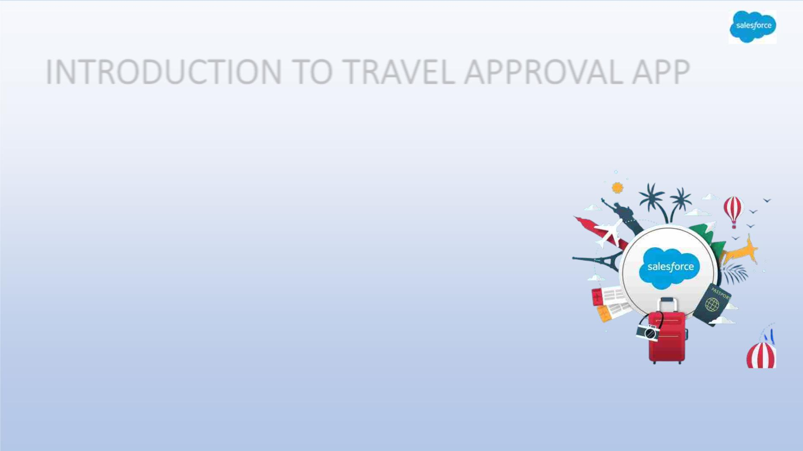
INTRODUCTION TO TRAVEL APPROVAL APP
• The travel approval project in Salesforce is a system designed
to automate and streamline the process of requesting and
approving travel expenses for employees. The project involves
several components, including a custom object to track travel
requests, a custom approval process, and various integrations
with external systems.
•
Overall, the travel approval project in Salesforce provides a
streamlined and efficient way for employees to request and
manage travel expenses, while also providing managers with the
tools they need to ensure that all expenses are approved and
accounted for.

Slide 5
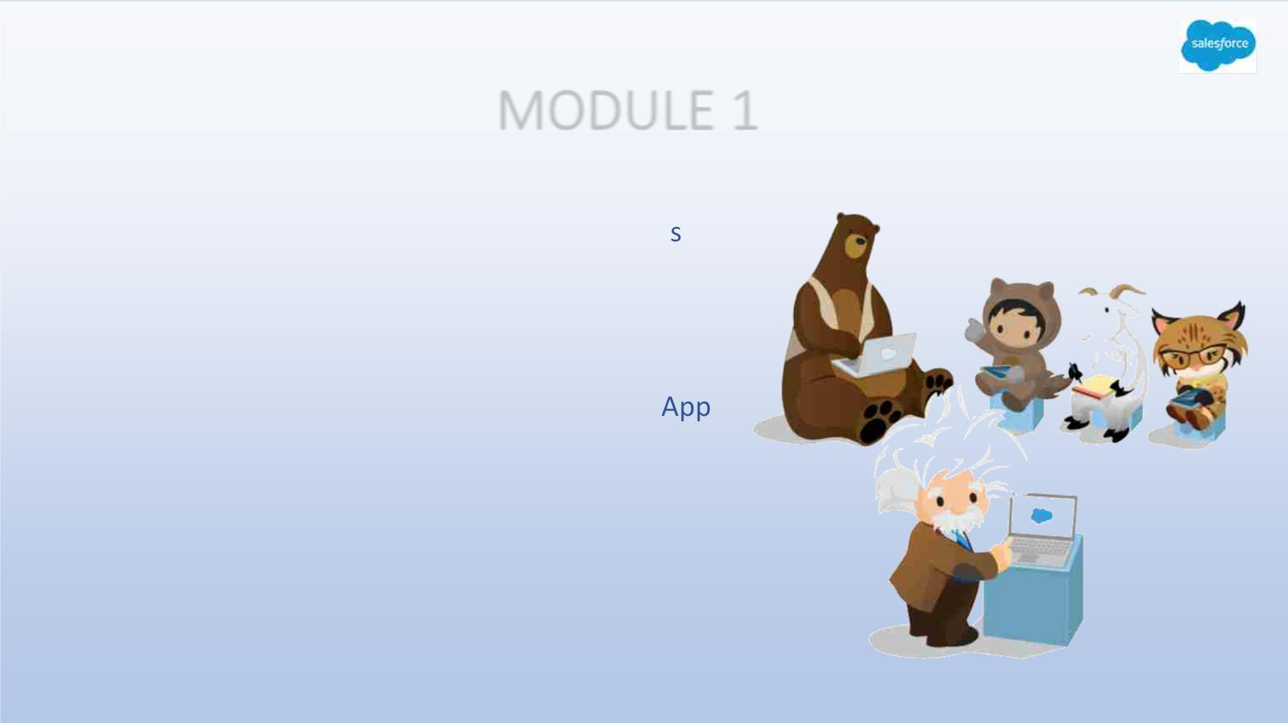
MODULE 1
• This project module focuses on the non-coding
approach to modifying the user interface, a
you customize an app that tracks company
travel.
• Create Custom App, Objects, Fields &
Relationships, and how you customize the
using declarative tools.

Slide 6
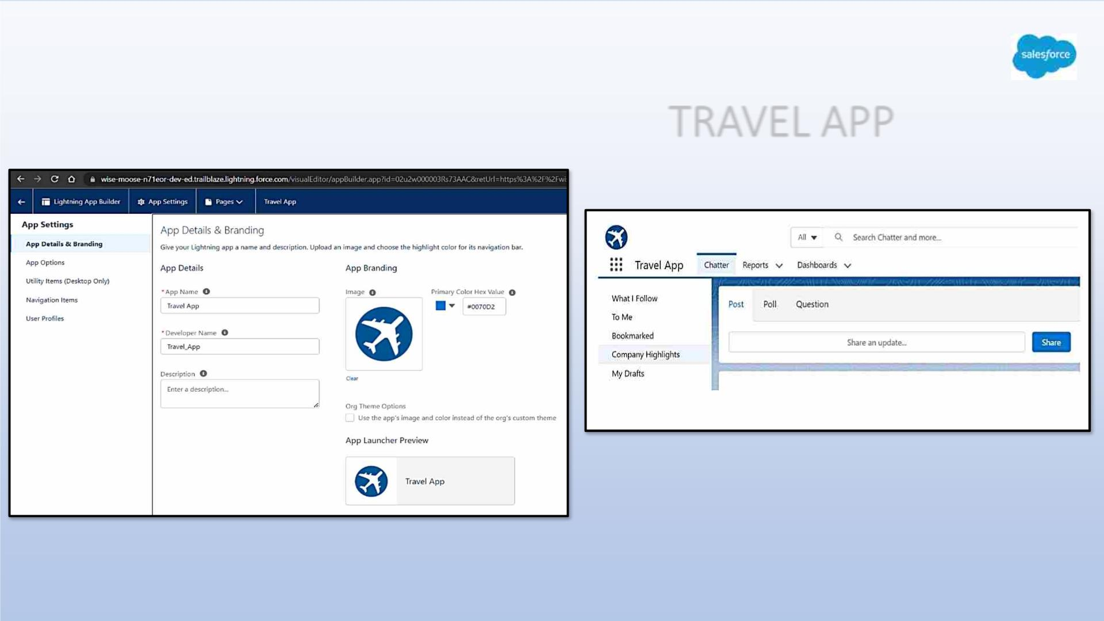
Exercise -1
Creating Lightning App: TRAVEL APP

Slide 7
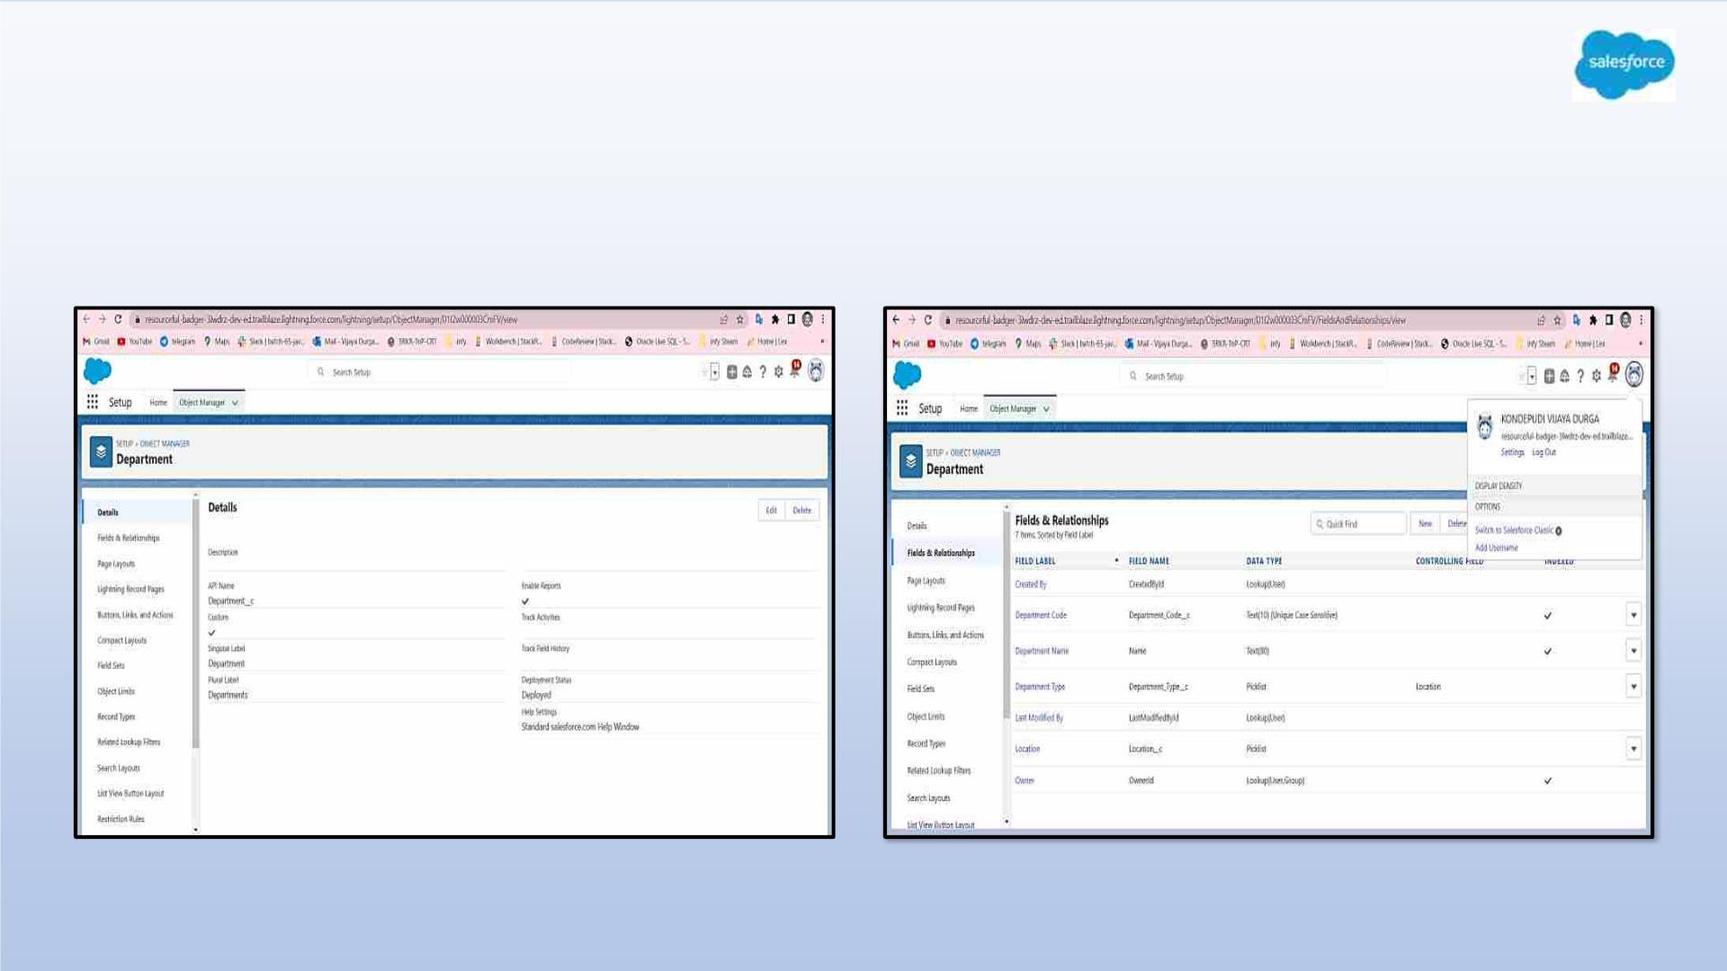
Custom object Department and Creating custom fields in Department object

Slide 8
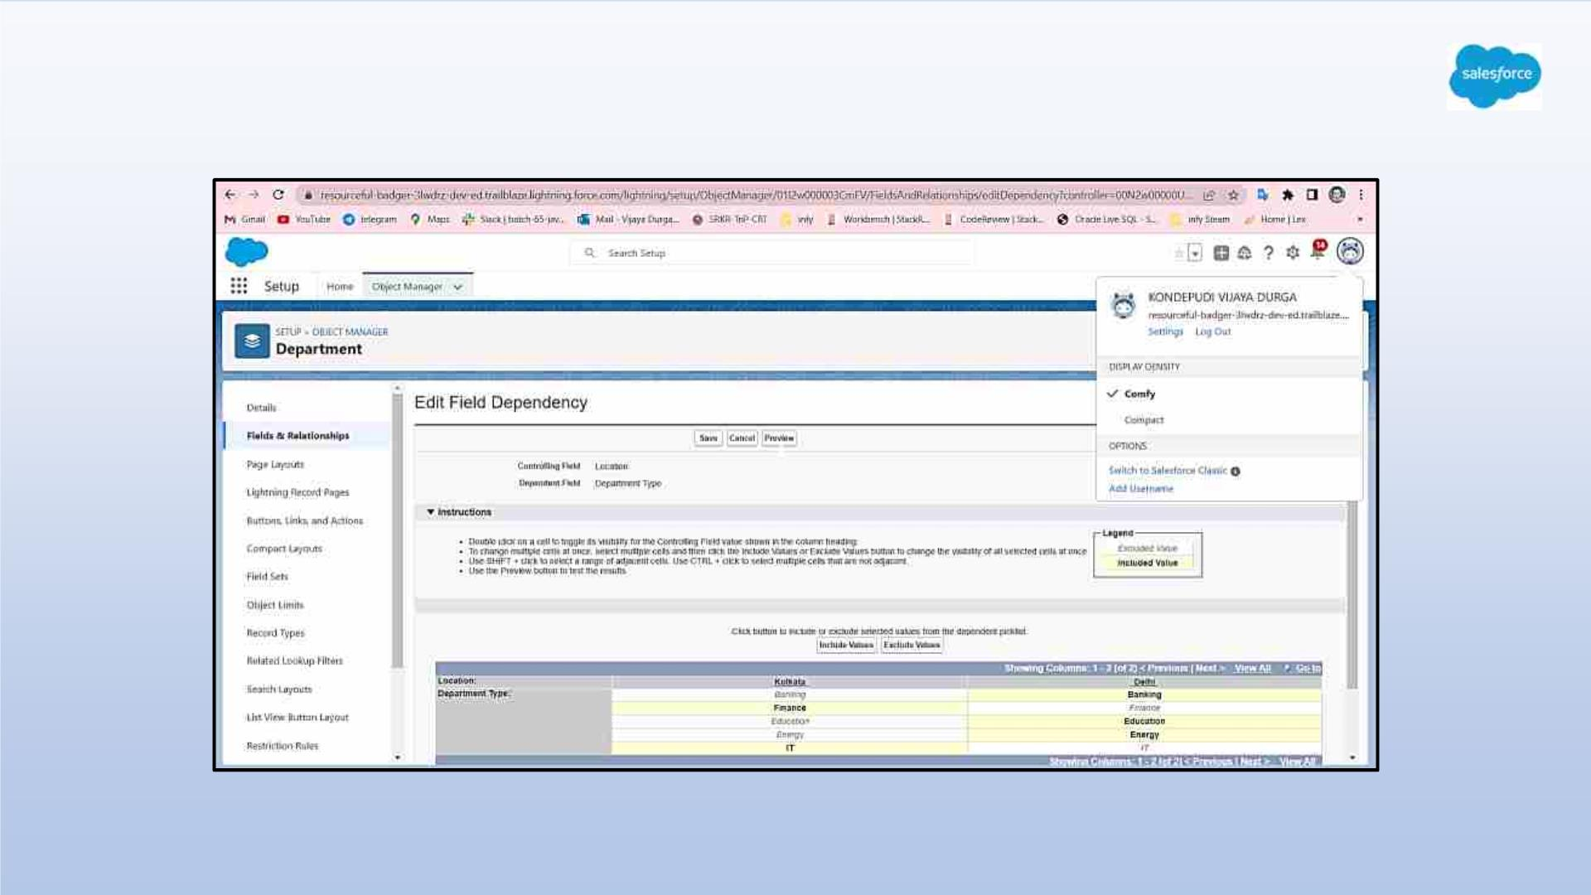
Field dependency in department

Slide 9
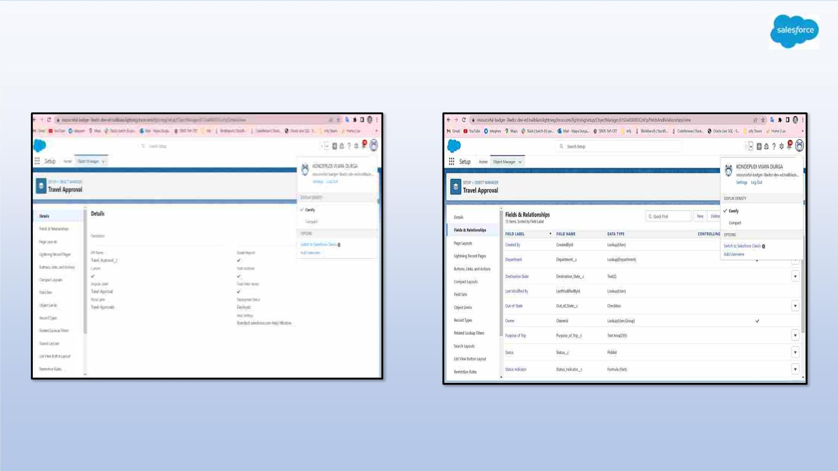
Creating Custom Object Travel Approval and Custom Fields in that Object

Slide 10
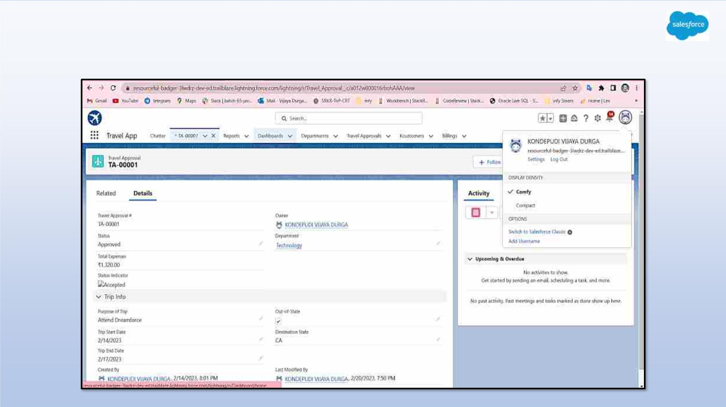
After creating travel approval object with fields, it looks as shown below

Slide 11
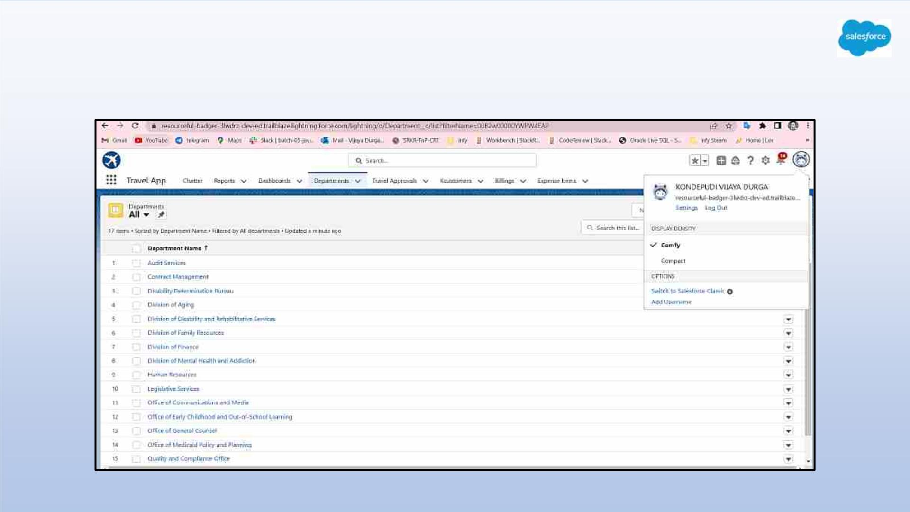
Importing Department records using data import wizard and
imported record data status can viewed below

Slide 12
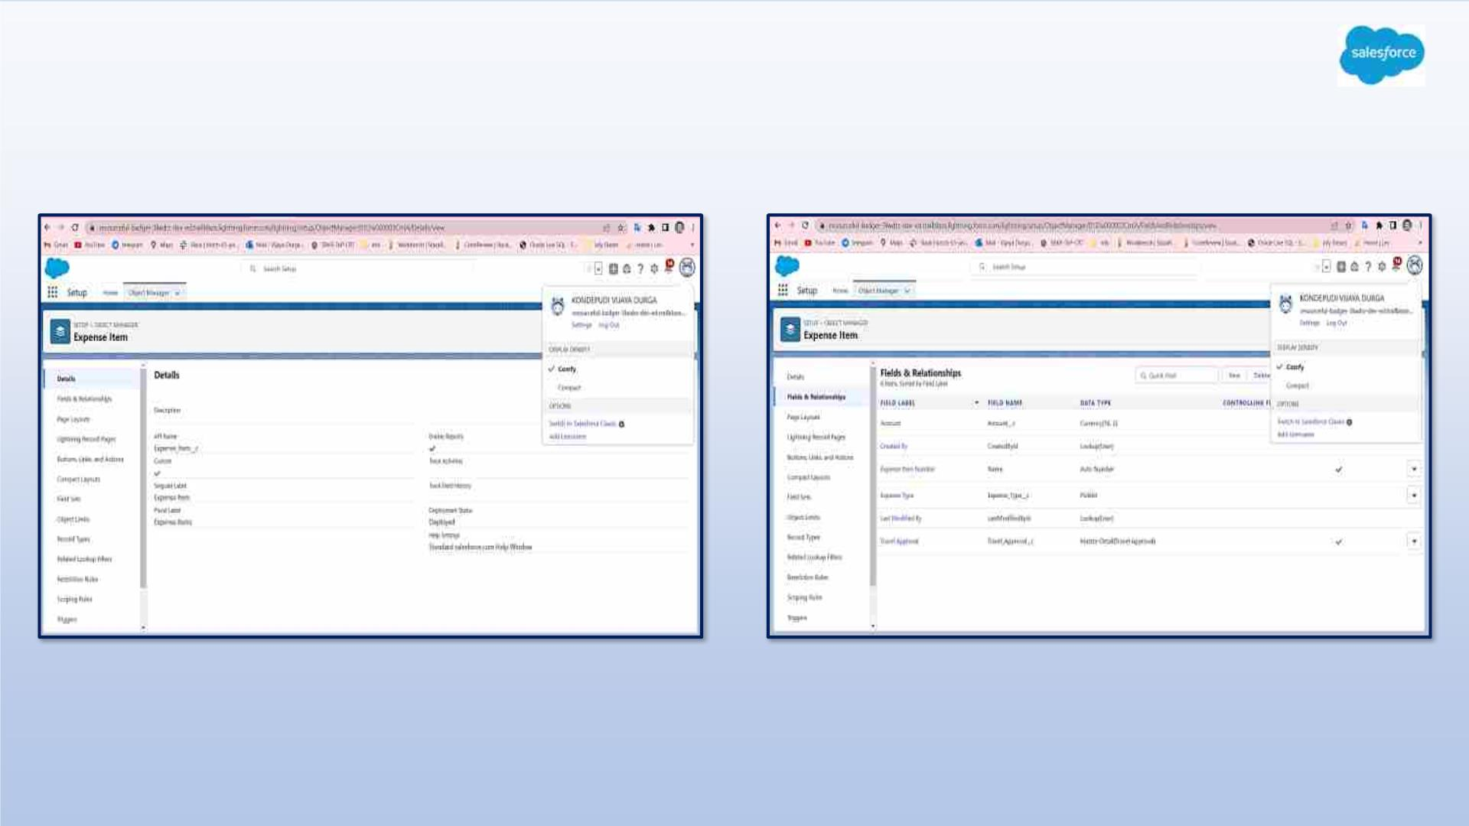
Exercise - 2
Creating Expense Item custom object and Custom fields in Expense Item object

Slide 13
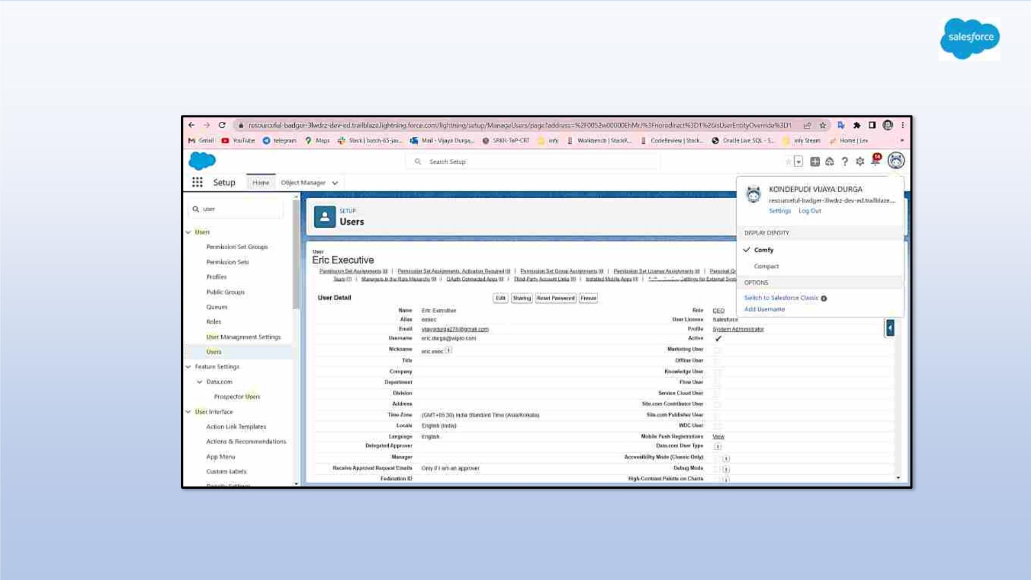
Created Eric User

Slide 14
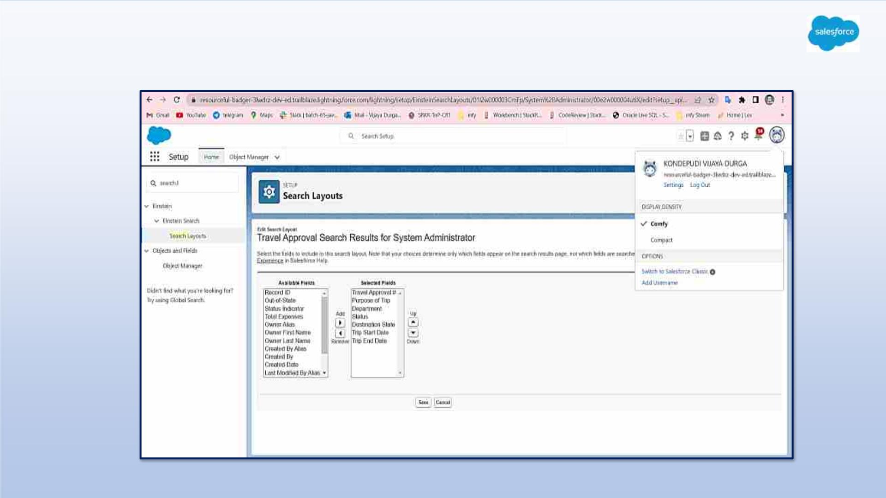
Customize the Travel Approval Default search layout

Slide 15
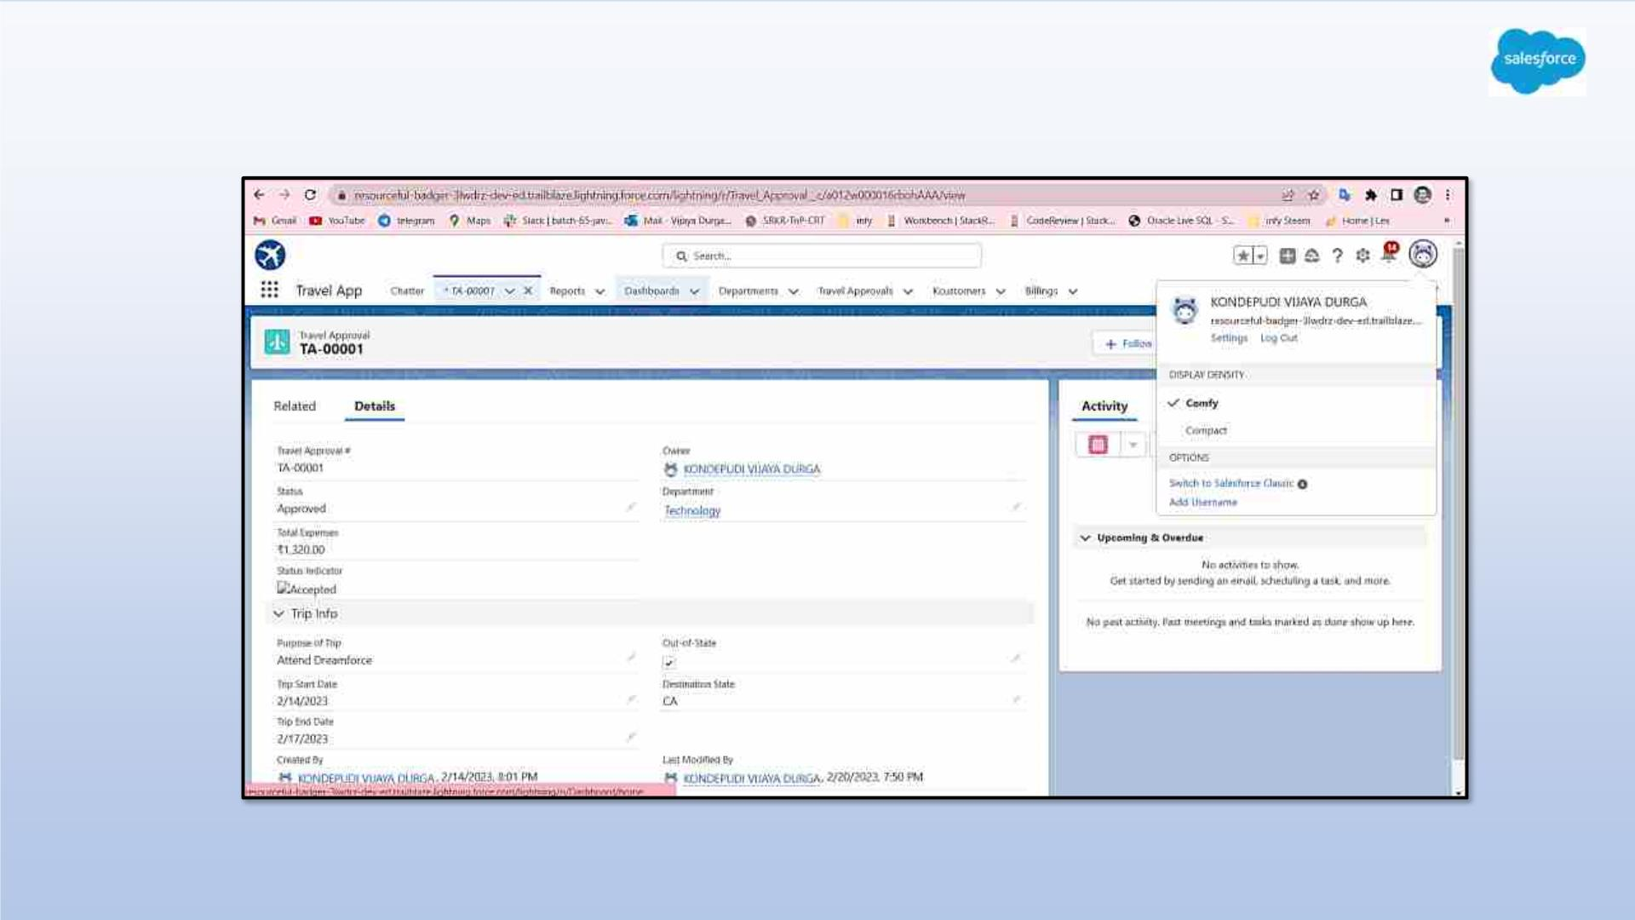
Customizing page layout

Slide 16
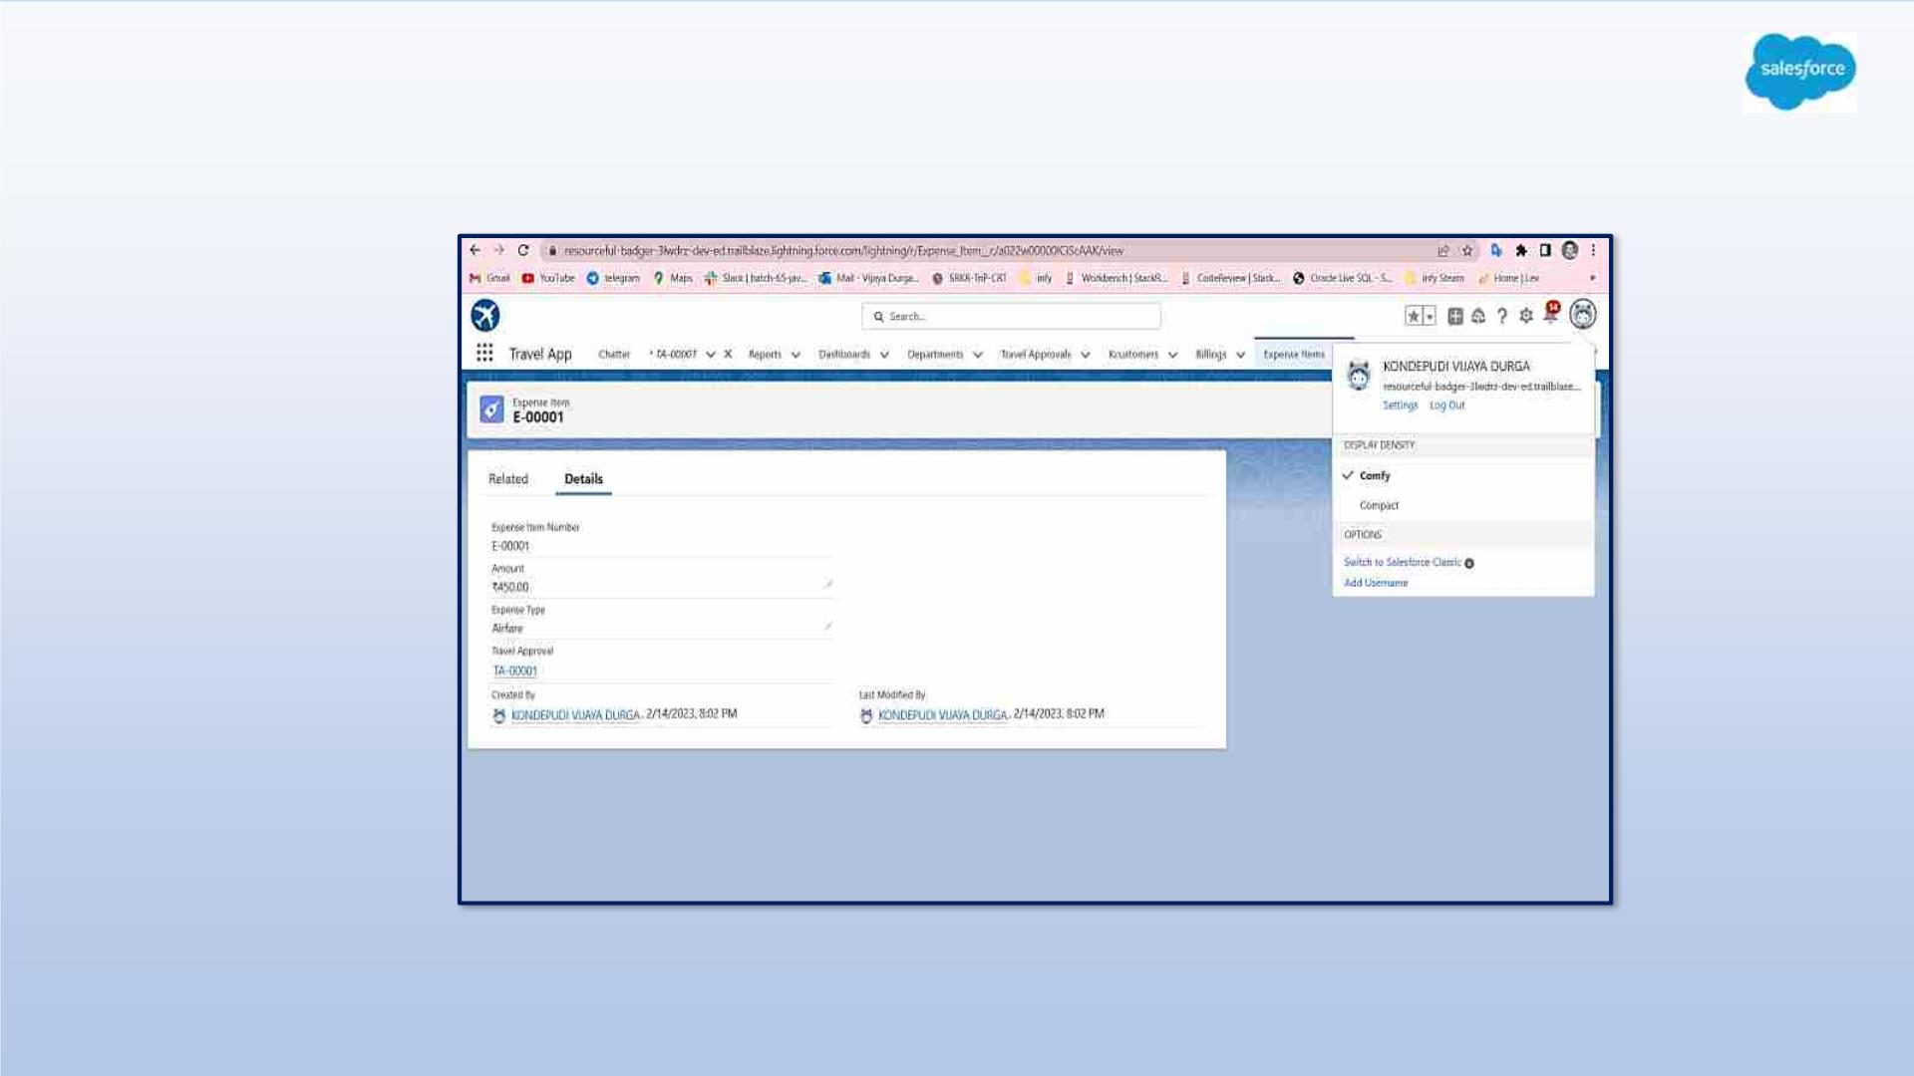
Test the app:

Slide 17
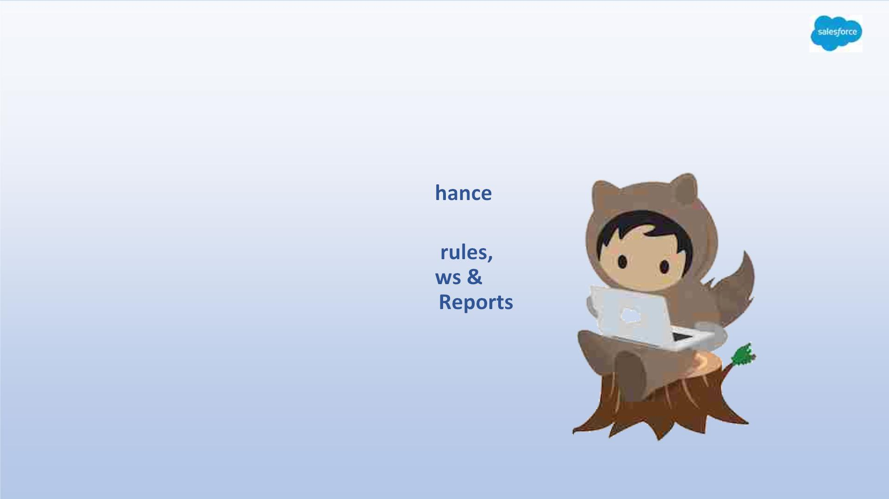
MODULE - 2
• This project module focuses on the
Automation and Analytics Tools to en
your custom App development.
• Define Business logic using Validation
Roll-up summary fields, Formulas, Flo
how you track Travel Approvals using
and Dashboards.

Slide 18
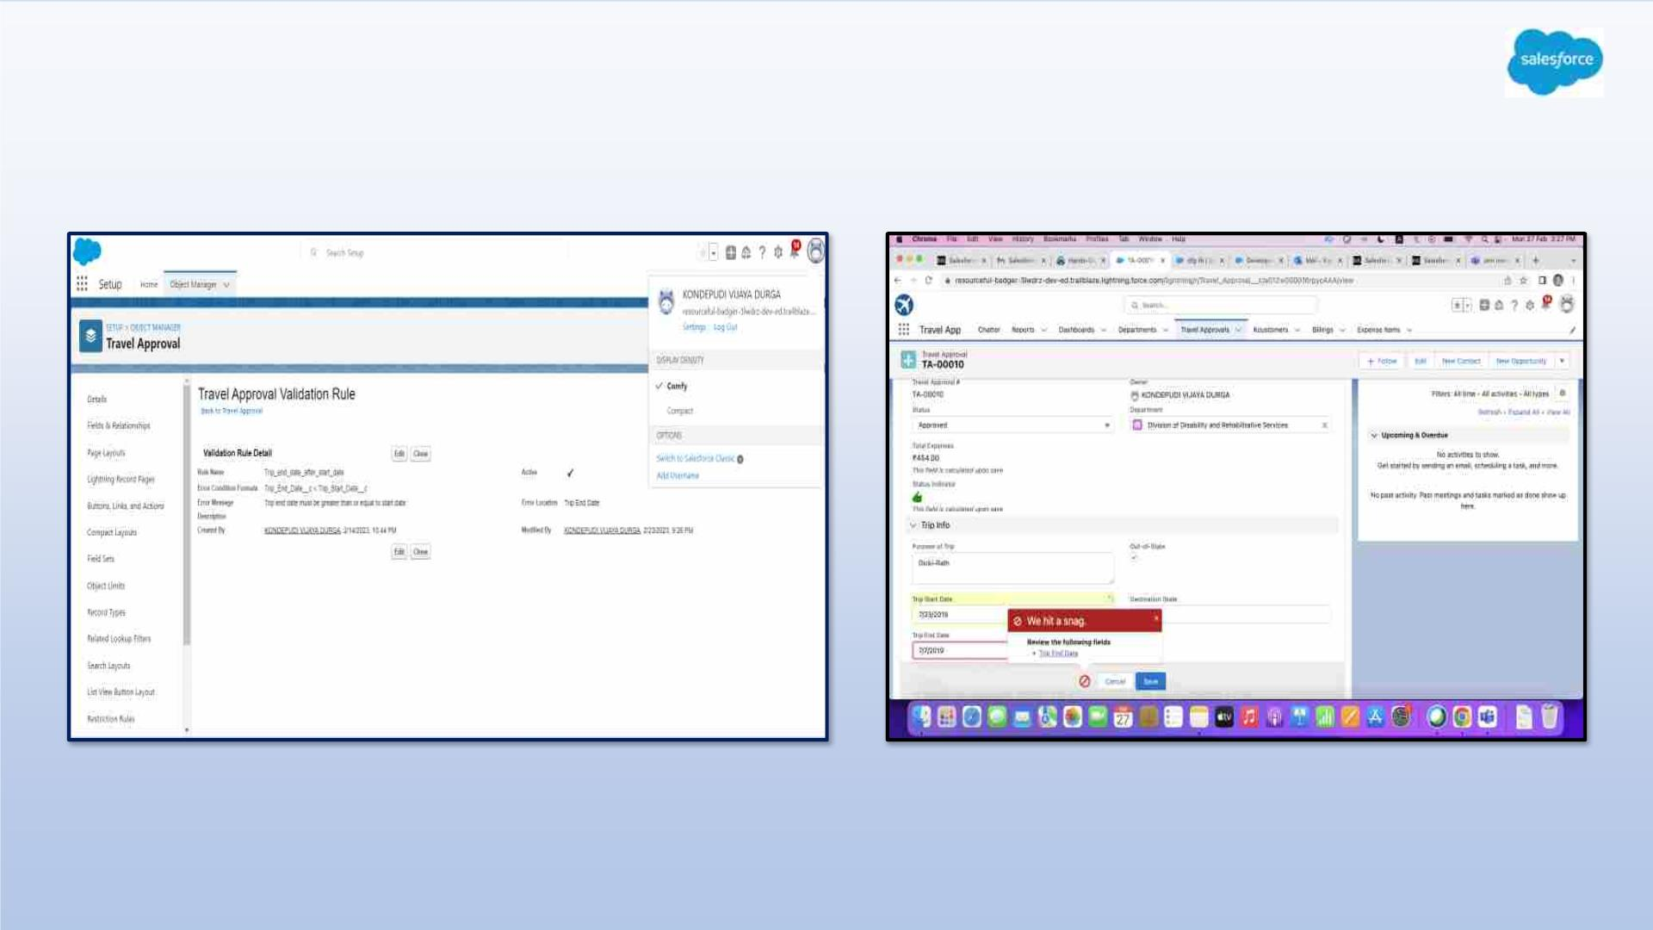
Validation Rule that trip end date always >= trip start date

Slide 19
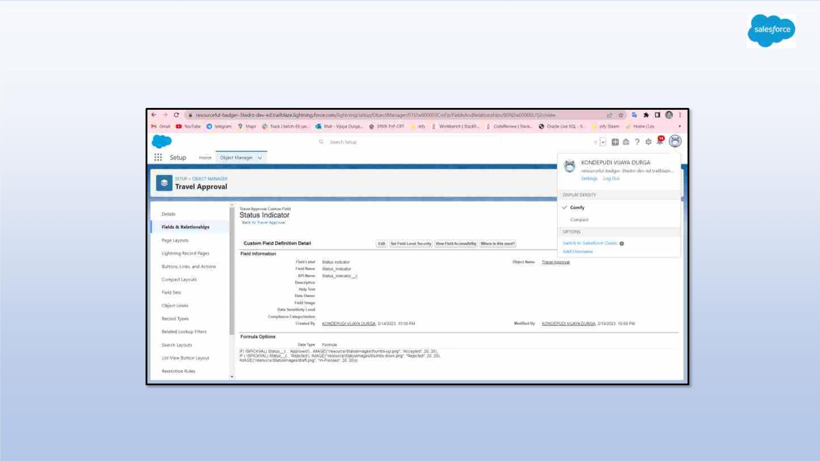
Creating Formula Fields

Slide 20
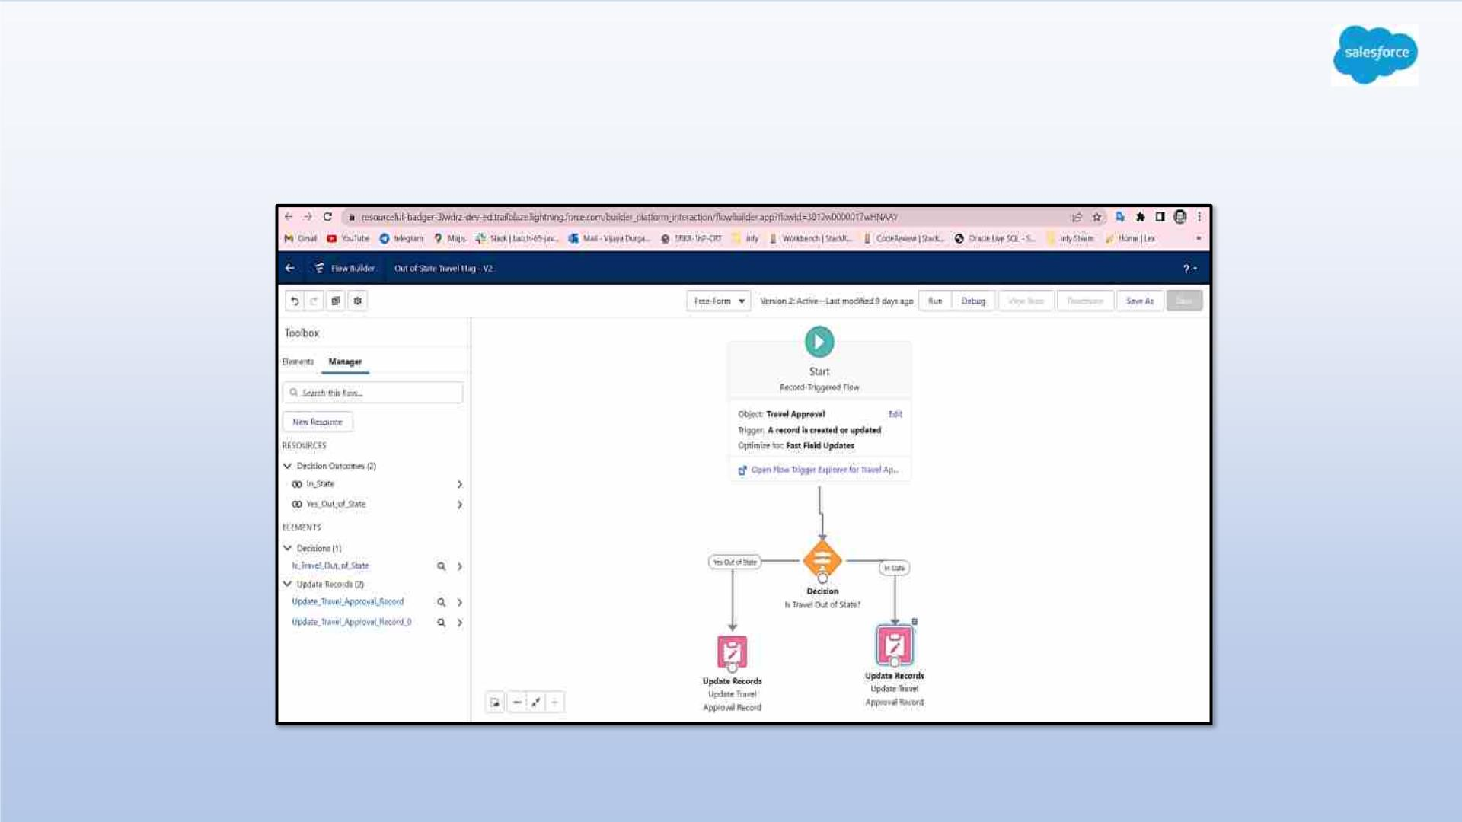
Create a flow looks as shown , save and activate

Slide 21
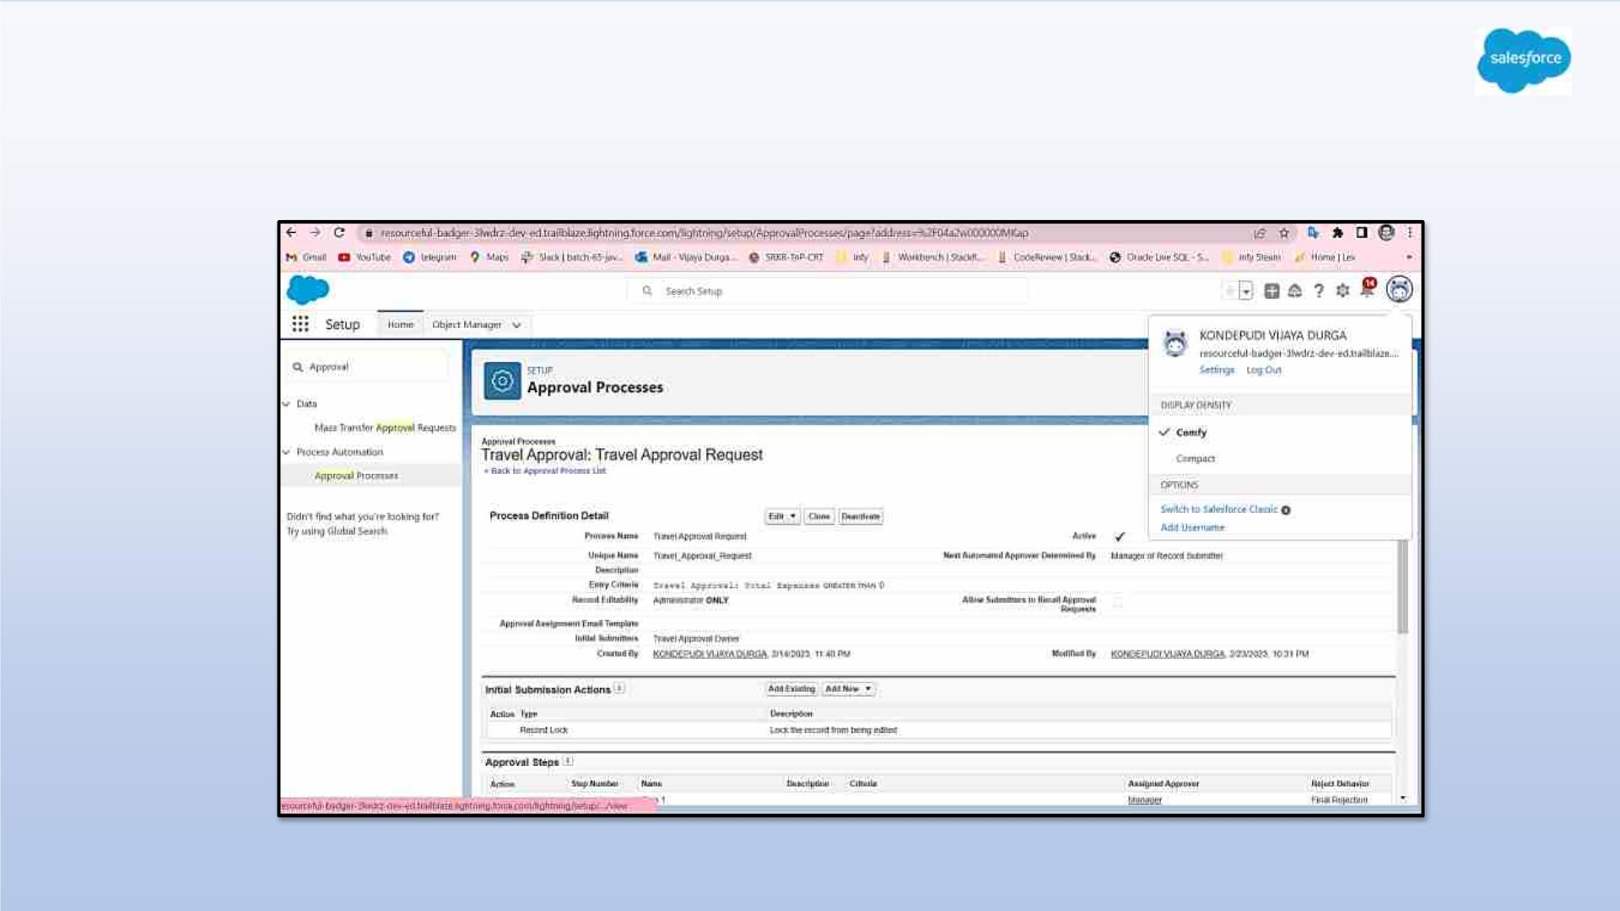
Creating an Approval Process to send travel approvals to manager or travel
coordinator

Slide 22
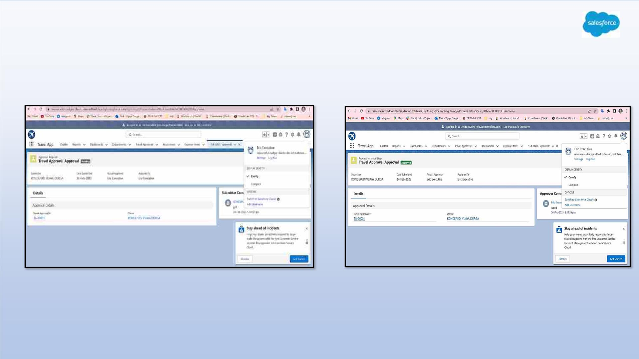
Testing the Approval Process Status is Pending Here, Next Submit For Approval

Slide 23
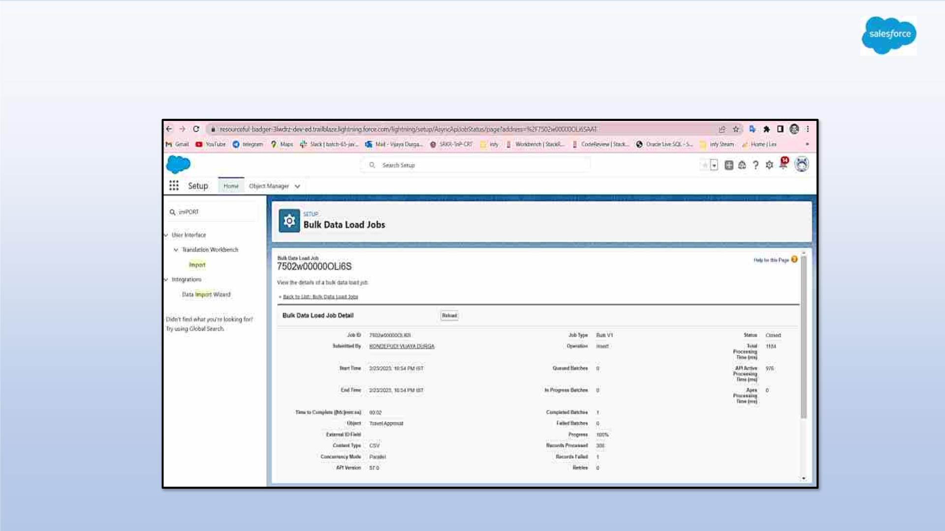
Using Data import wizard to import travel approval records , later the Records
imported successfully

Slide 24
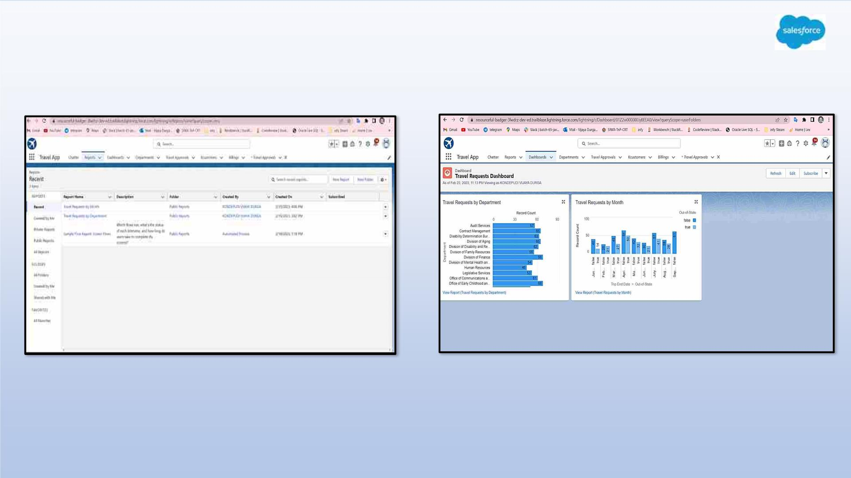
Created Reports and Dashboard

Slide 25

MODULE 3
• This project module focuses on the coding
approach to extend the functional capabilitie
of your custom App.

Slide 26
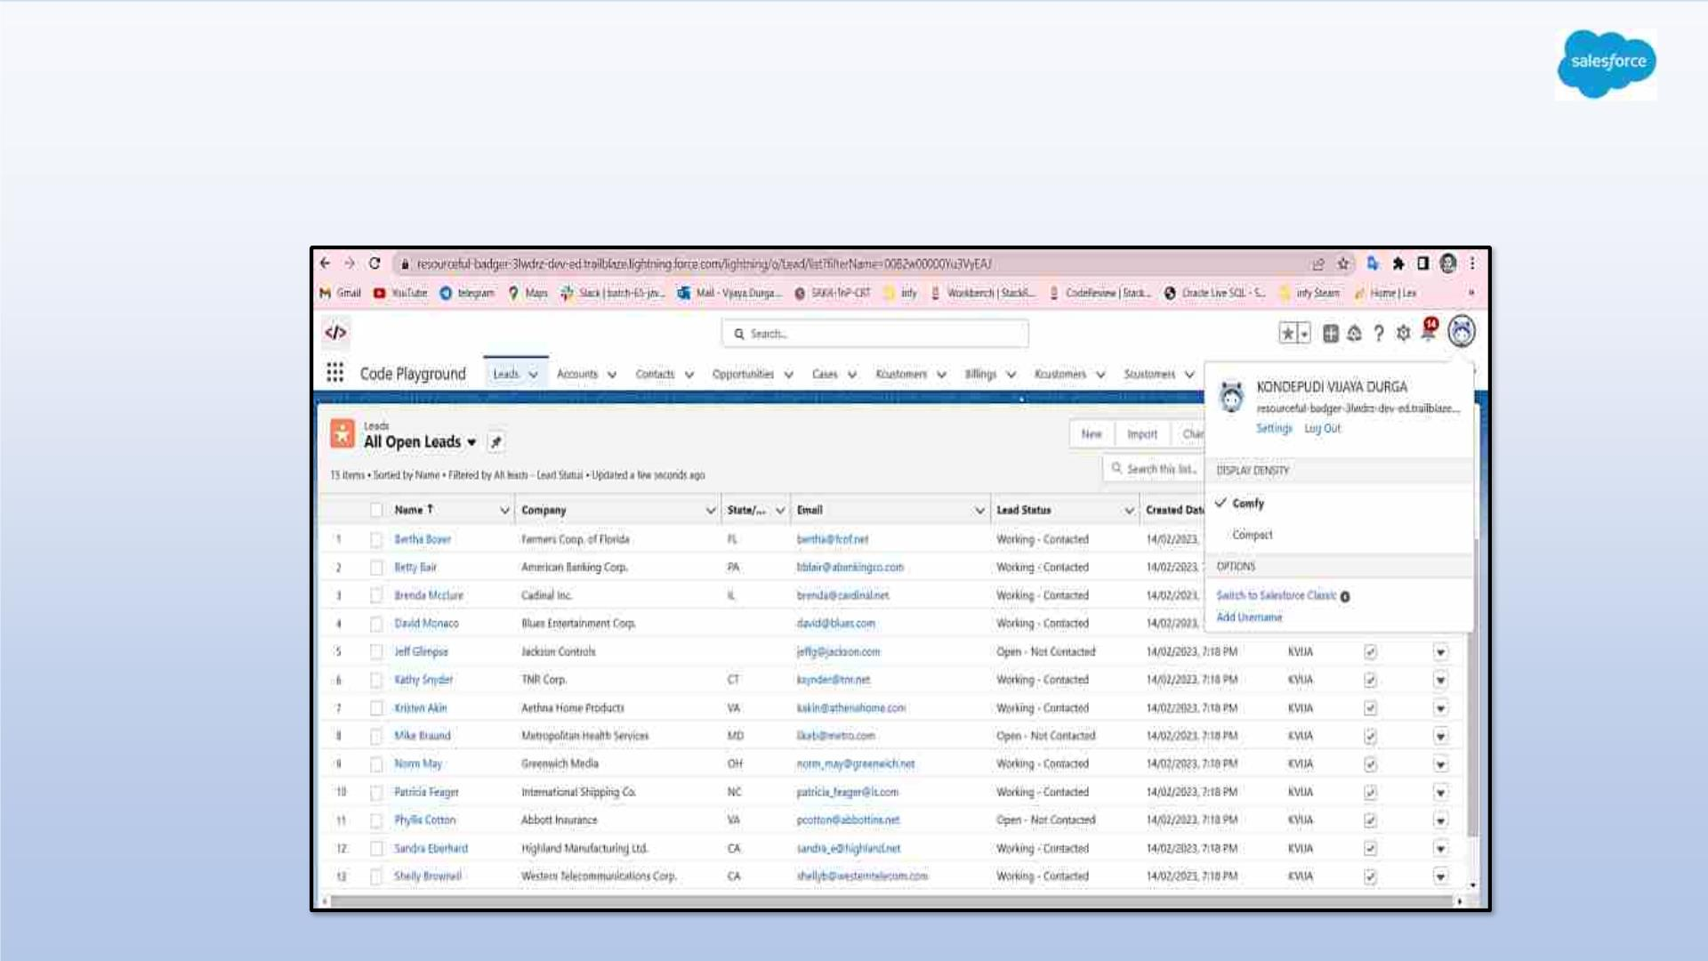
Exercise - 1
Creating Code Playground Lightning App with Lead, Account, Contact,
Opportunity, Case to navigation profile as system admin.

Slide 27
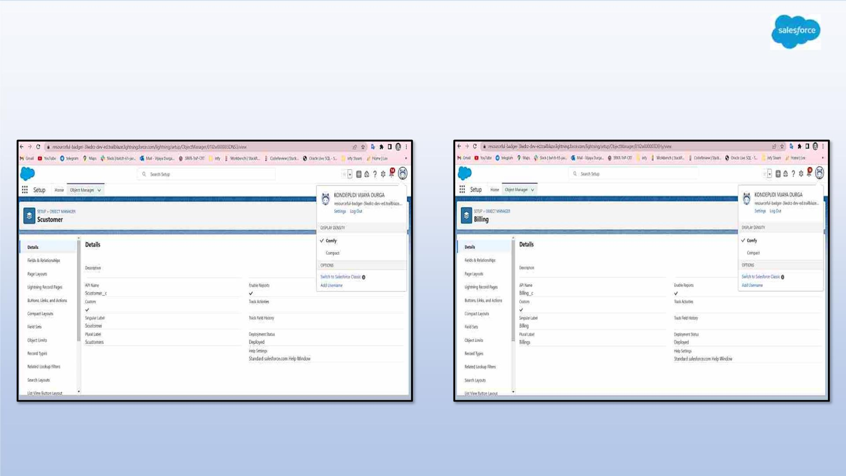
Creating custom objects Scustomer , Billing and add related fields

Slide 28
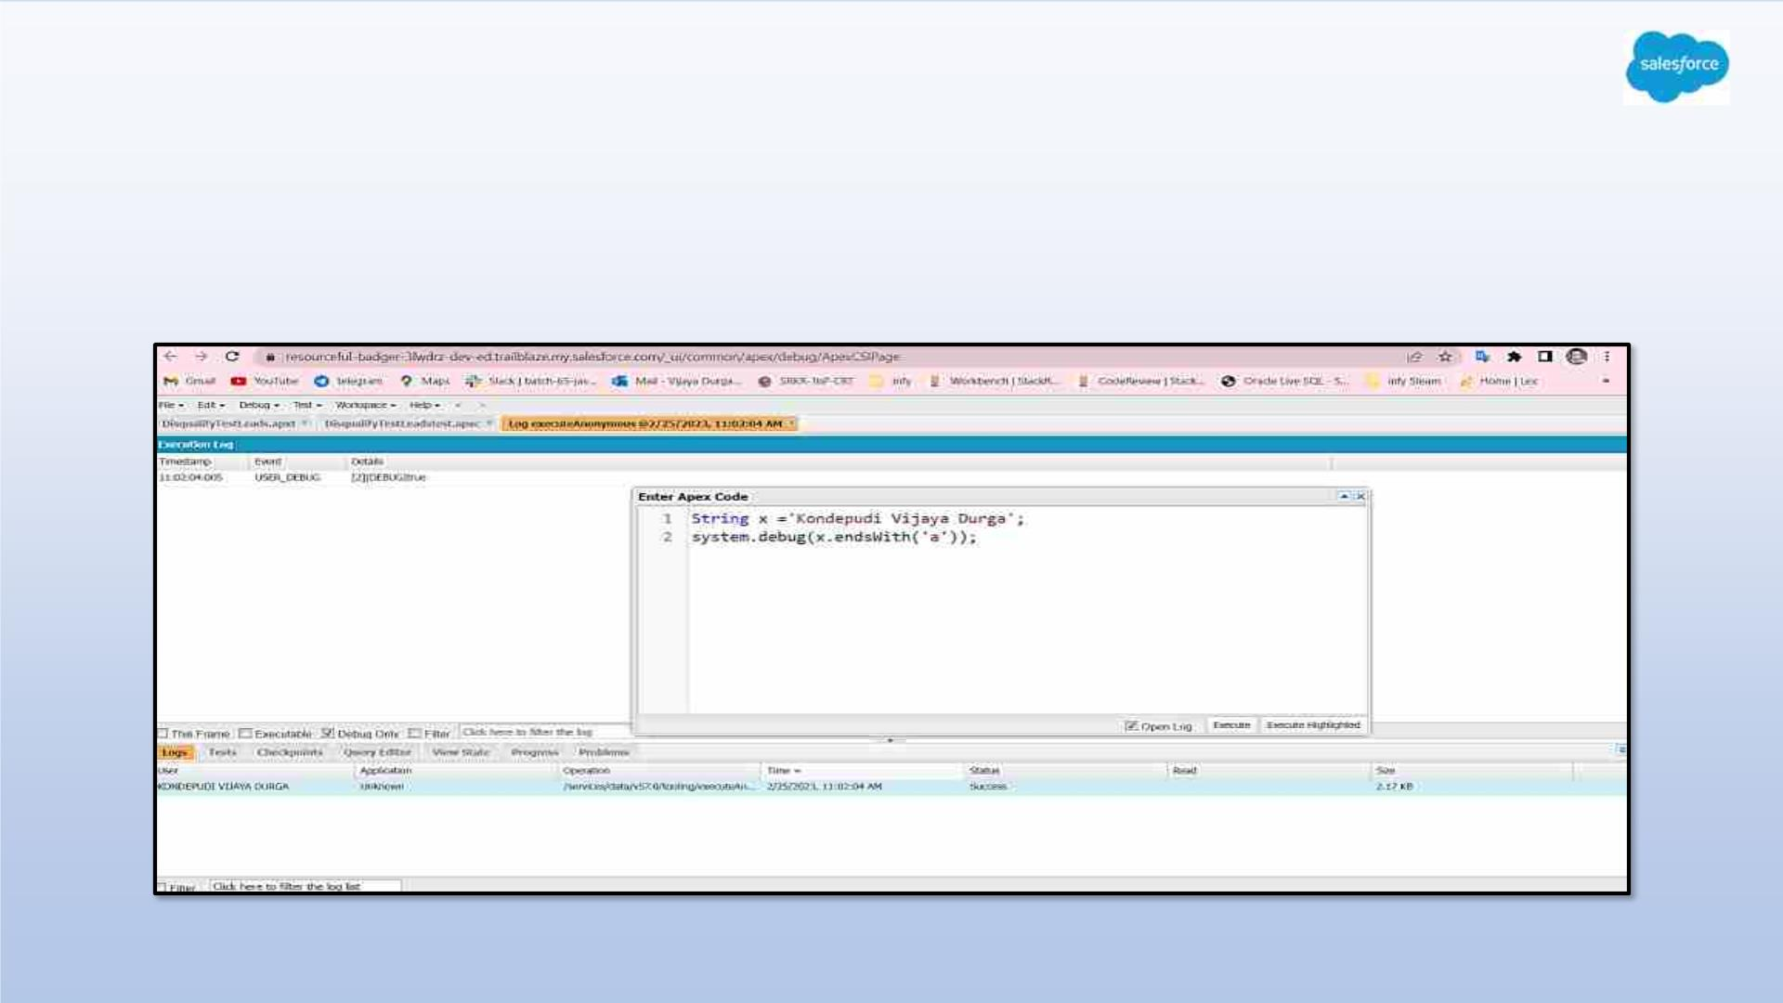
Exercise - 2
Define a String Variable & use string method ‘endsWith’ to display the output. By
clicking oh Debug and select open Anonymous window

Slide 29
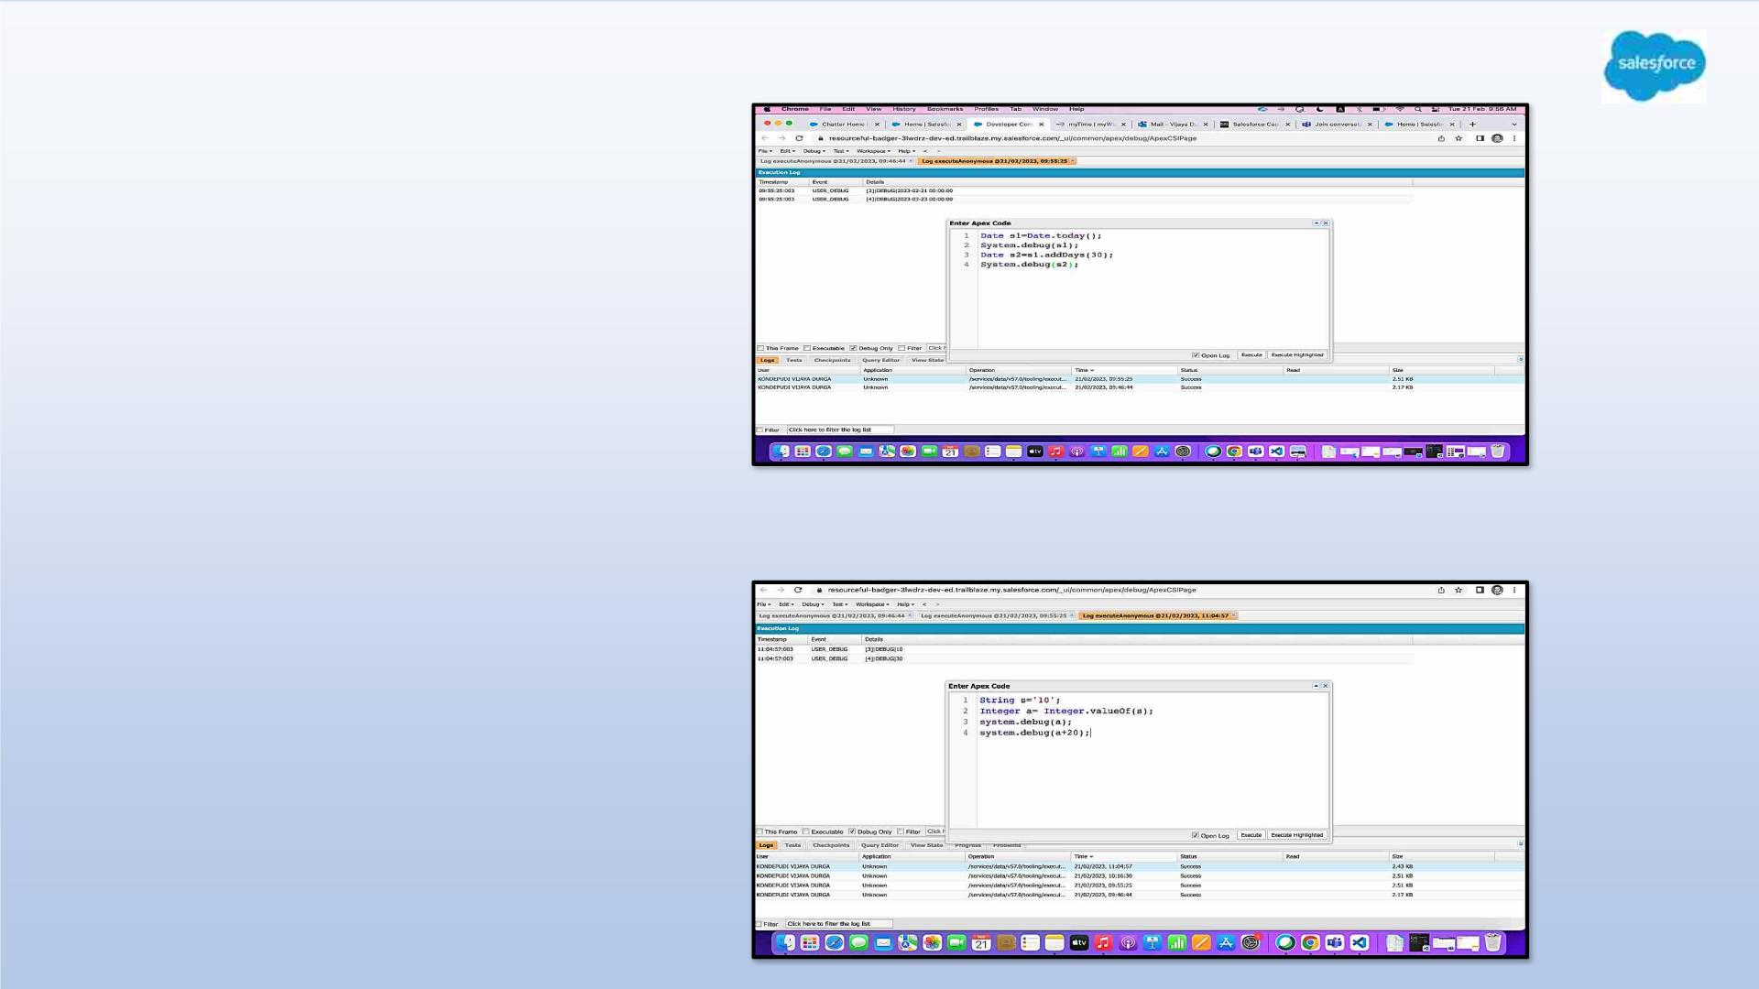
2. Define 2 Date type variables,
use Date method today() &
addDays(30) to displays the
output.
3. Display the Output of an
integer variable from string ‘10’
and then add 20 to it.

Slide 30
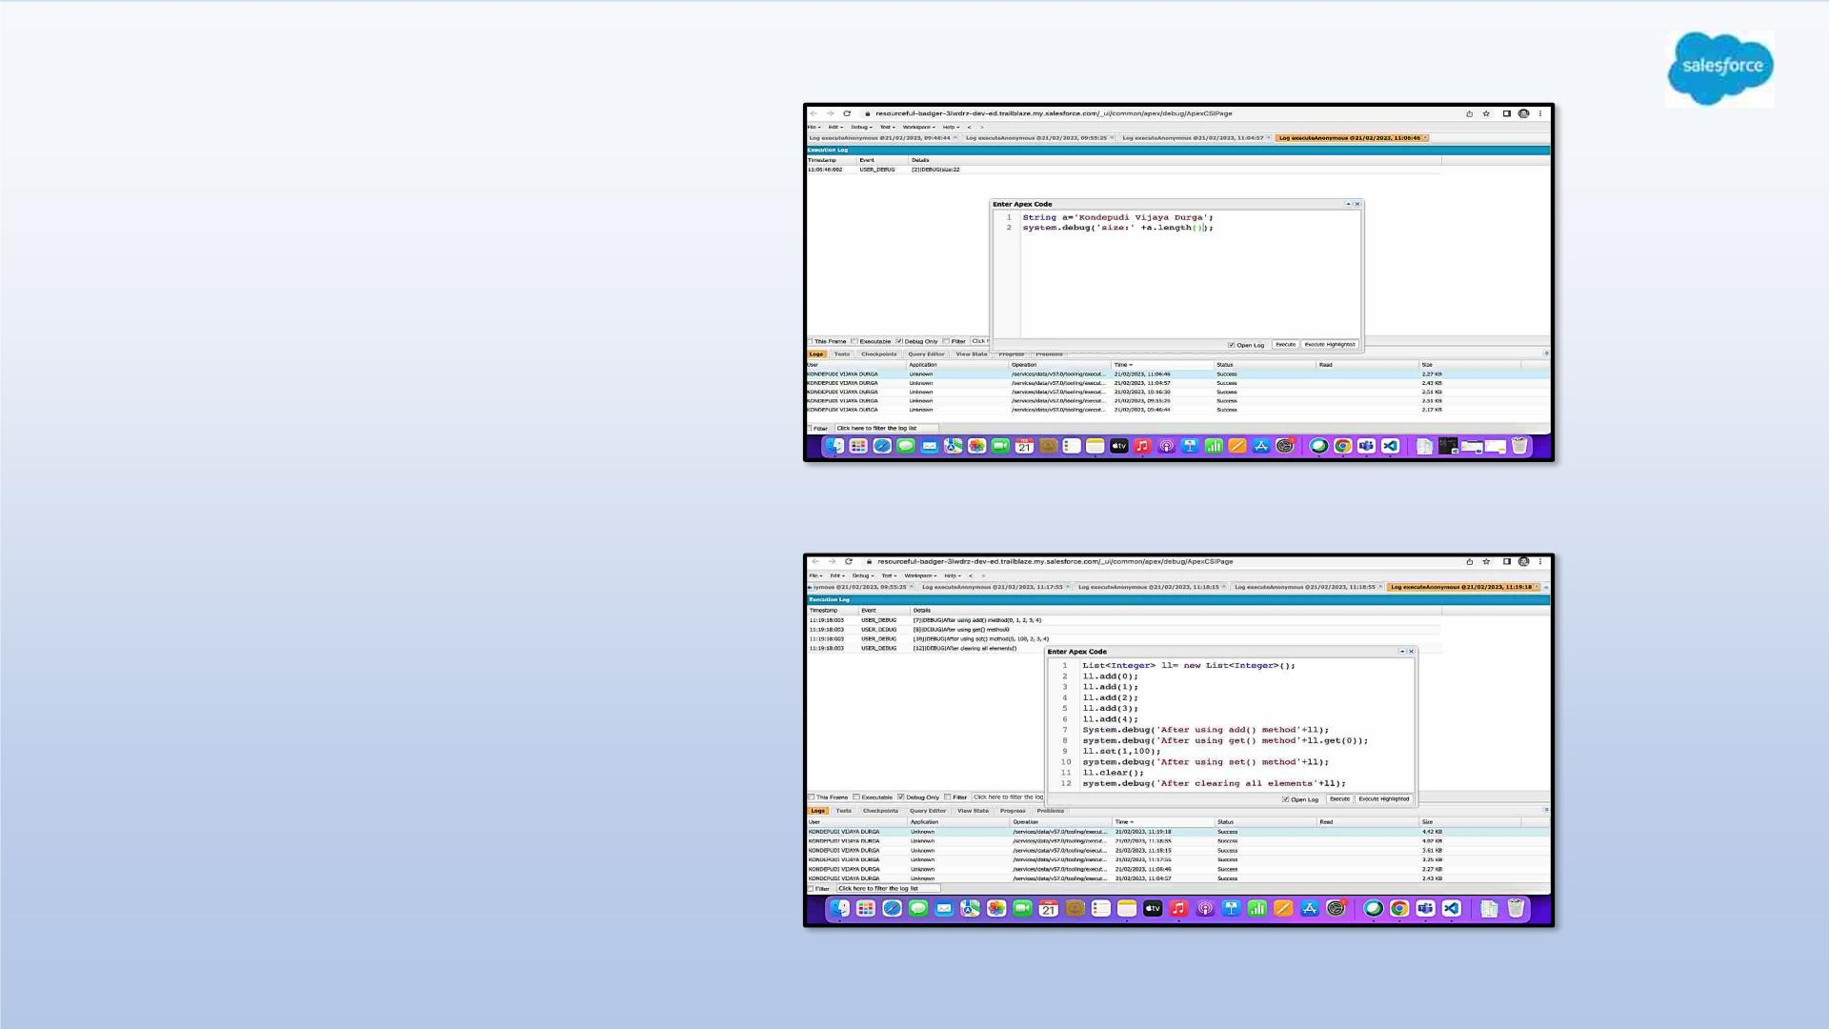
4.Define a string variable & Use
String method length() to Display
the output.
5.Define a list of integer and display
the output using add(), get(), set() ,
clear() , Methods.

Slide 31
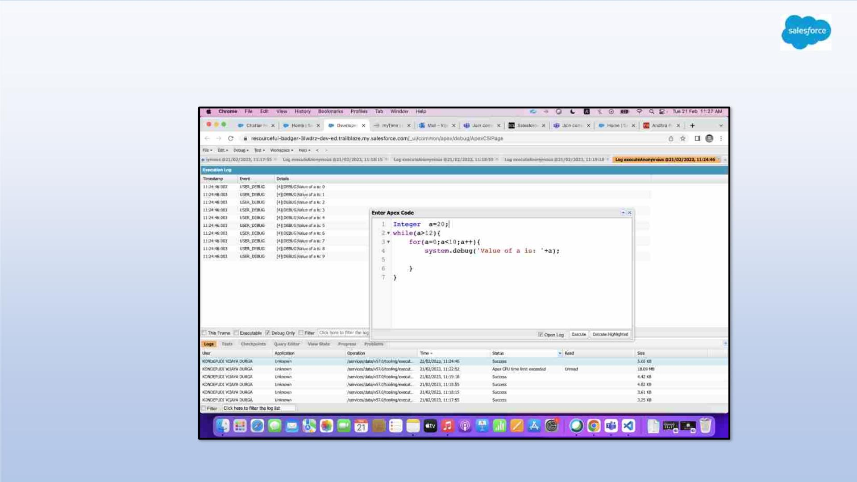
6.Use Execute Anonymous to define and execute the following code to display the
value of x = 0 to 9.

Slide 32
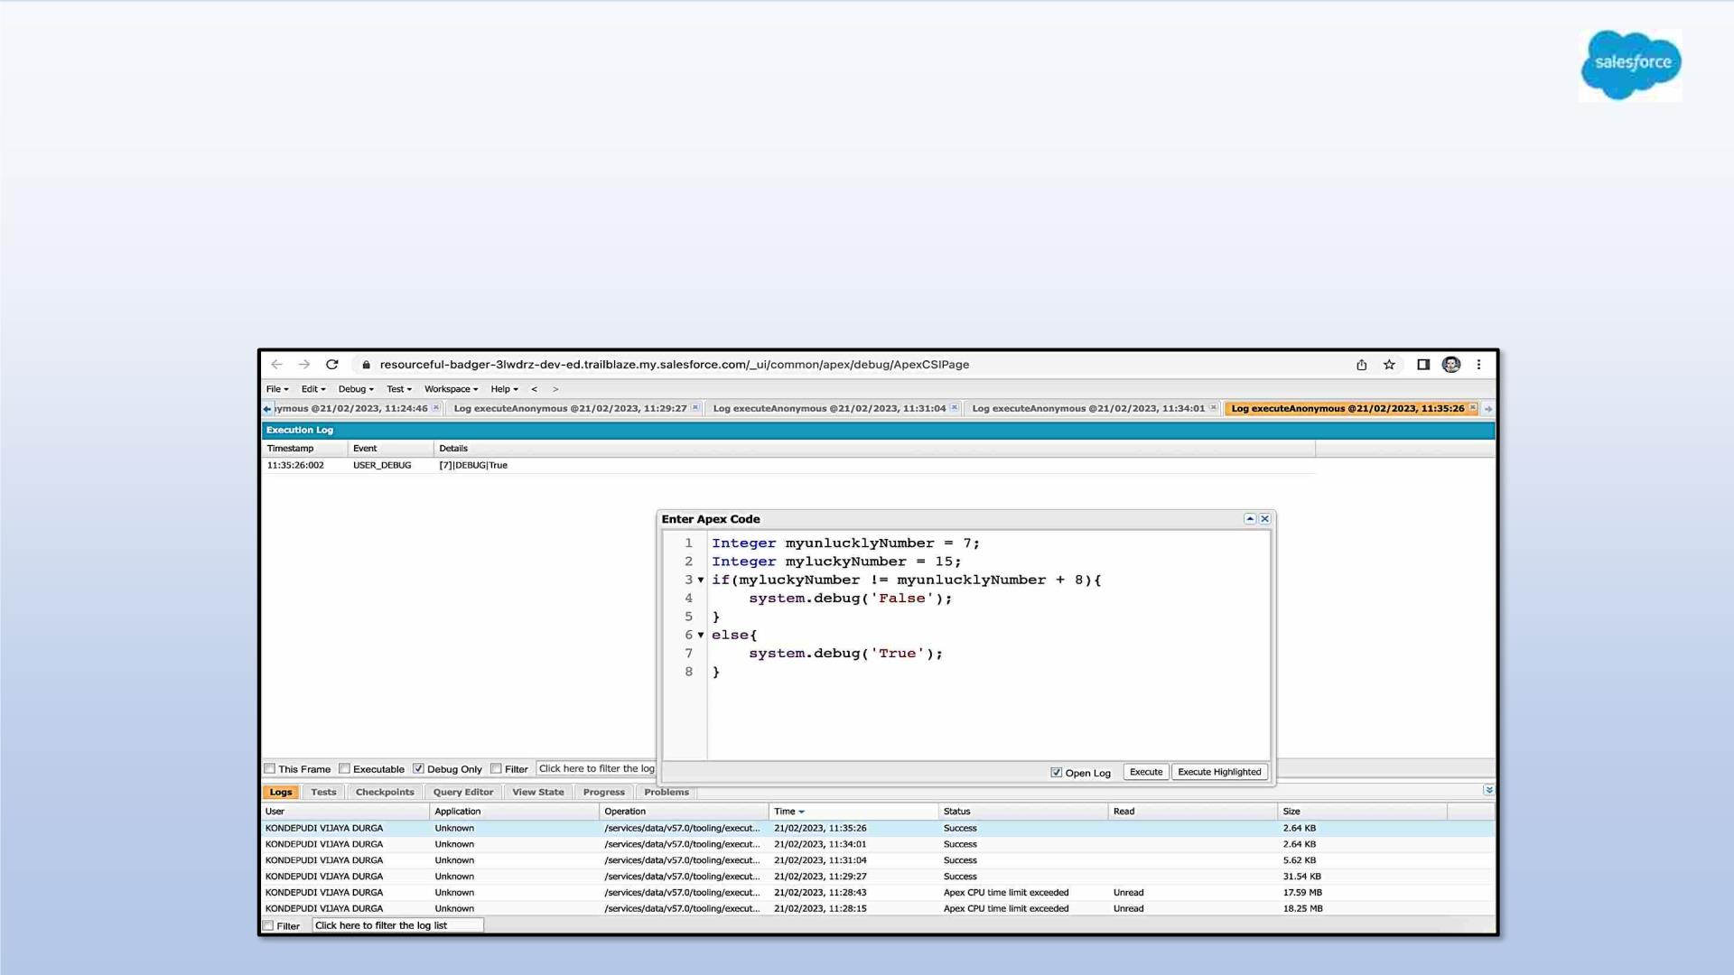
Exercise - 3
Answer the following in True or False:
Integer myunlucklyNumber = 7; Integer myluckyNumber = 15;
myluckyNumber != myunlucklyNumber + 8.

Slide 33
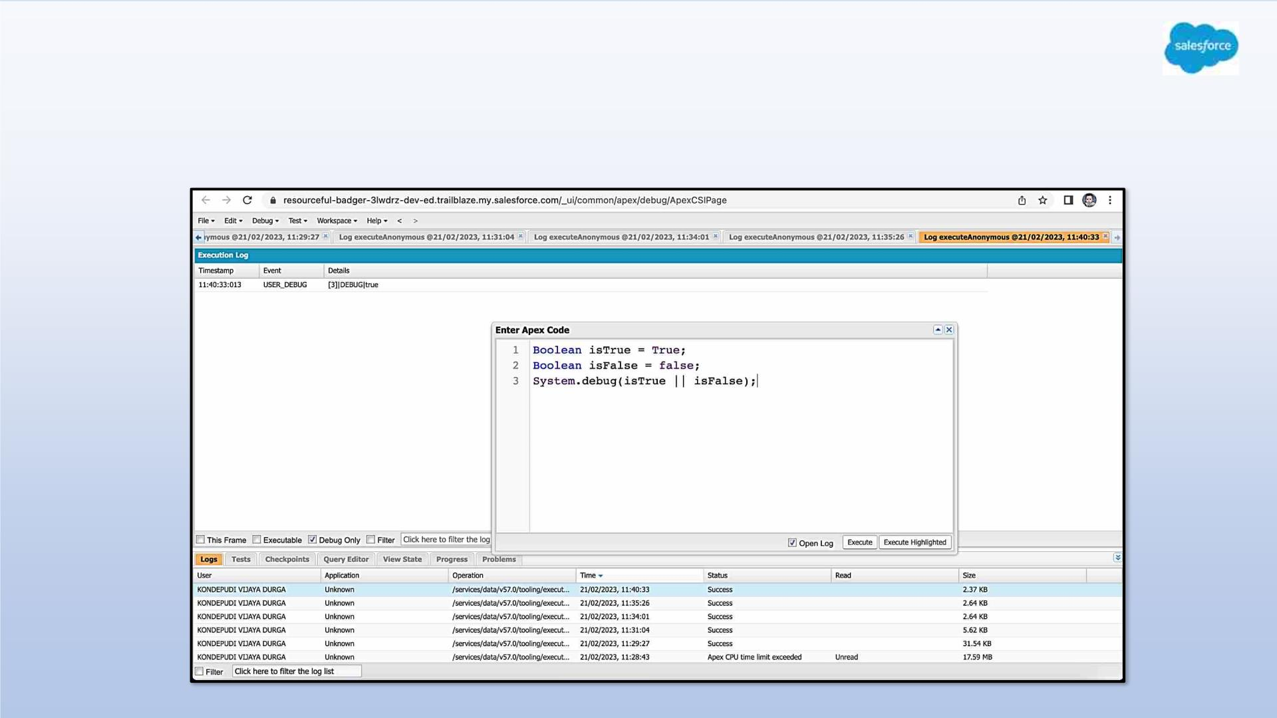
Exercise - 4
Answer the following in True Or False:
Boolean isFalse = false; Boolean isTrue = true;

Slide 34
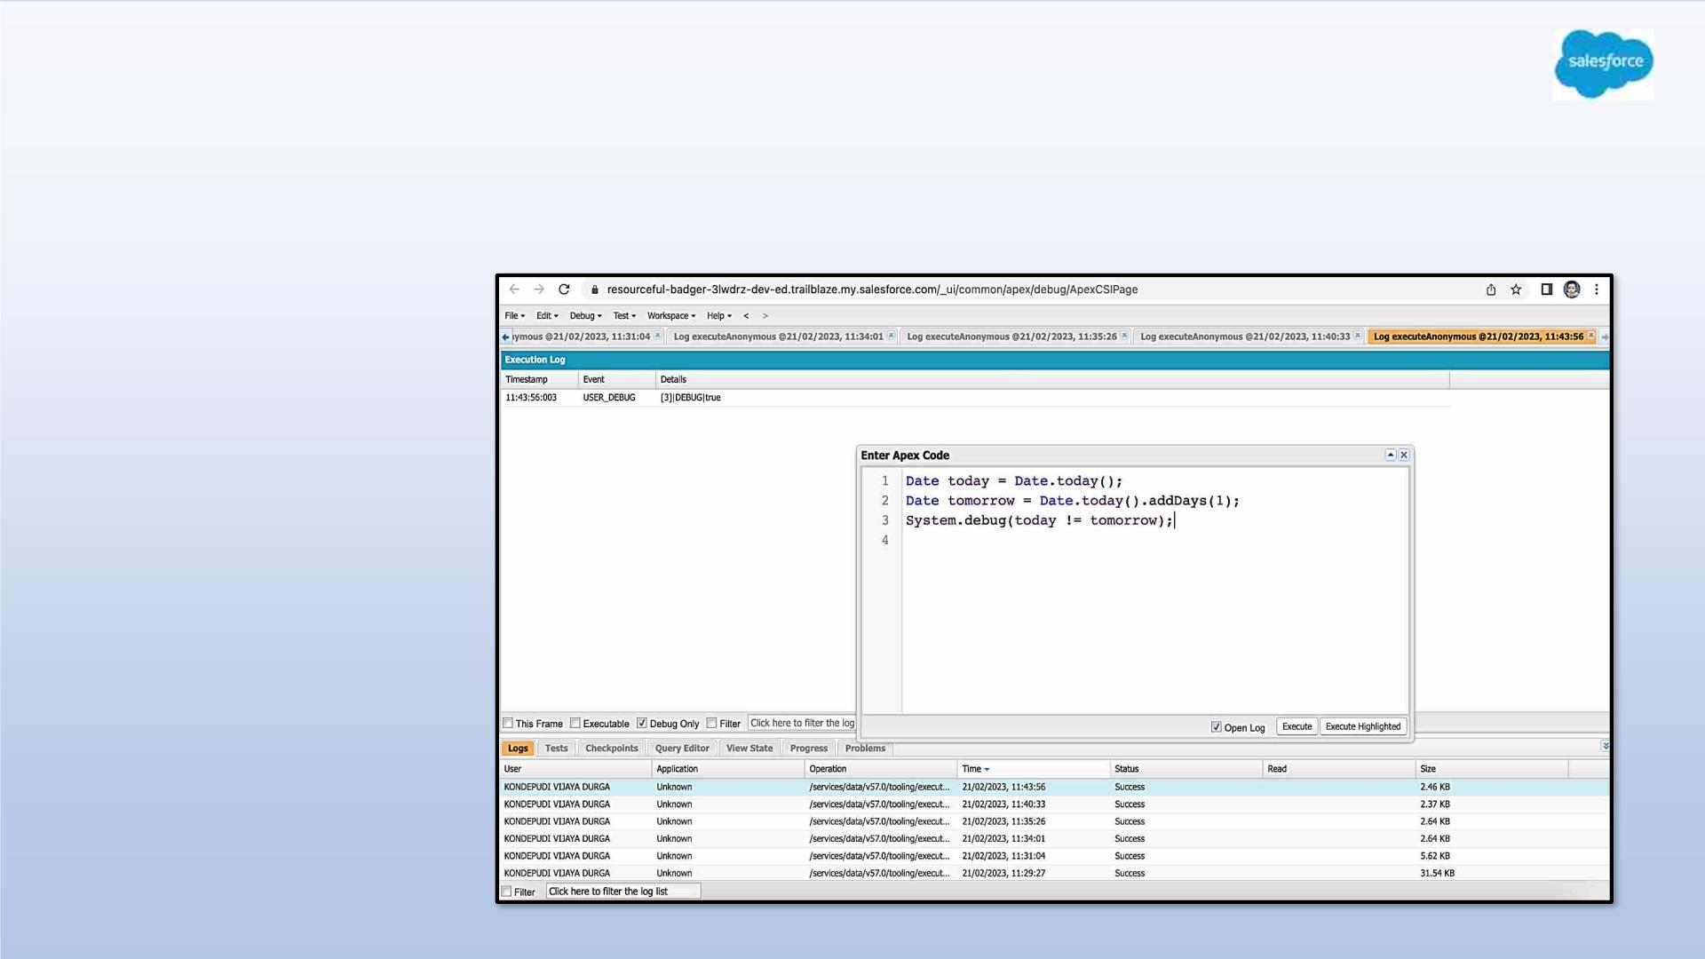
Exercise 5
Answer the following in True Or False:
Date tomorrow = Date.today().addDays(1);
Date today = Date.today();
today != tomorrow

Slide 35
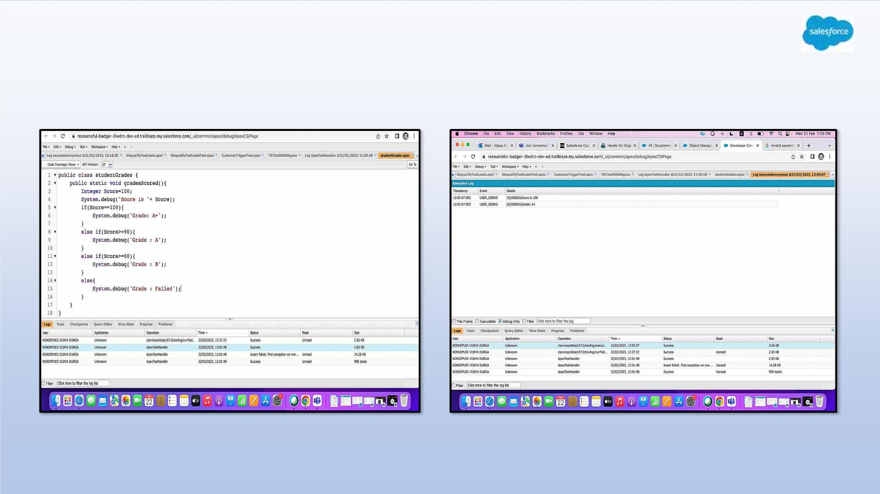
Exercise 6
Write a program and execute to demo the use of “If..else if...else”

Slide 36
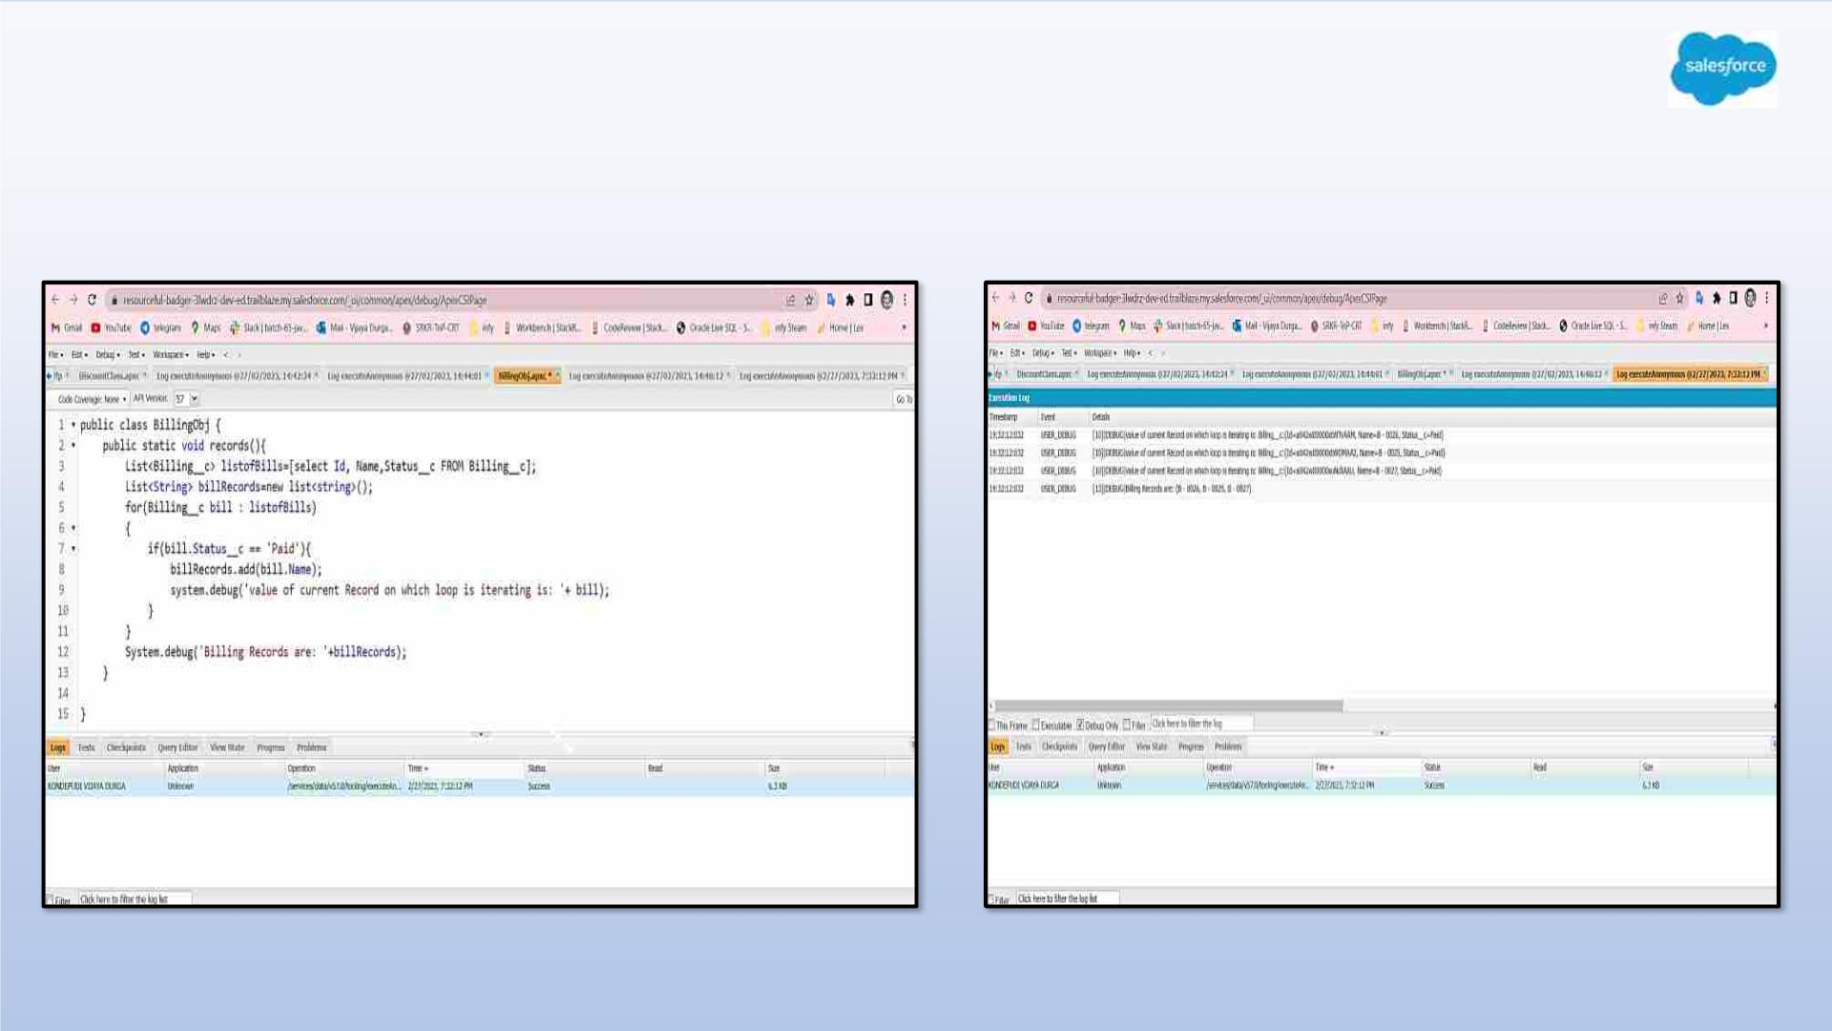
Exercise 7
Write a program to execute and demo the use of “Apex – for Loop”

Slide 37
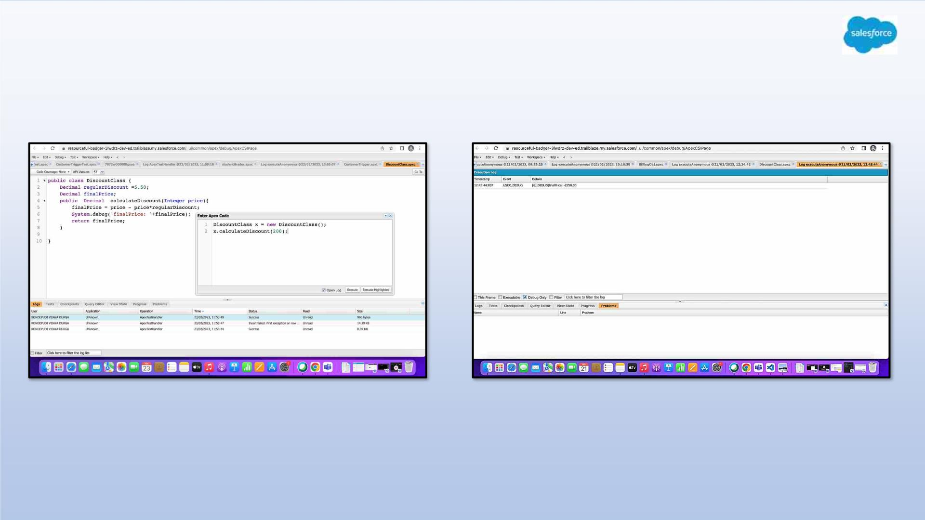
Exercise 8
Write a Class to demo the use of Constants in Apex

Slide 38
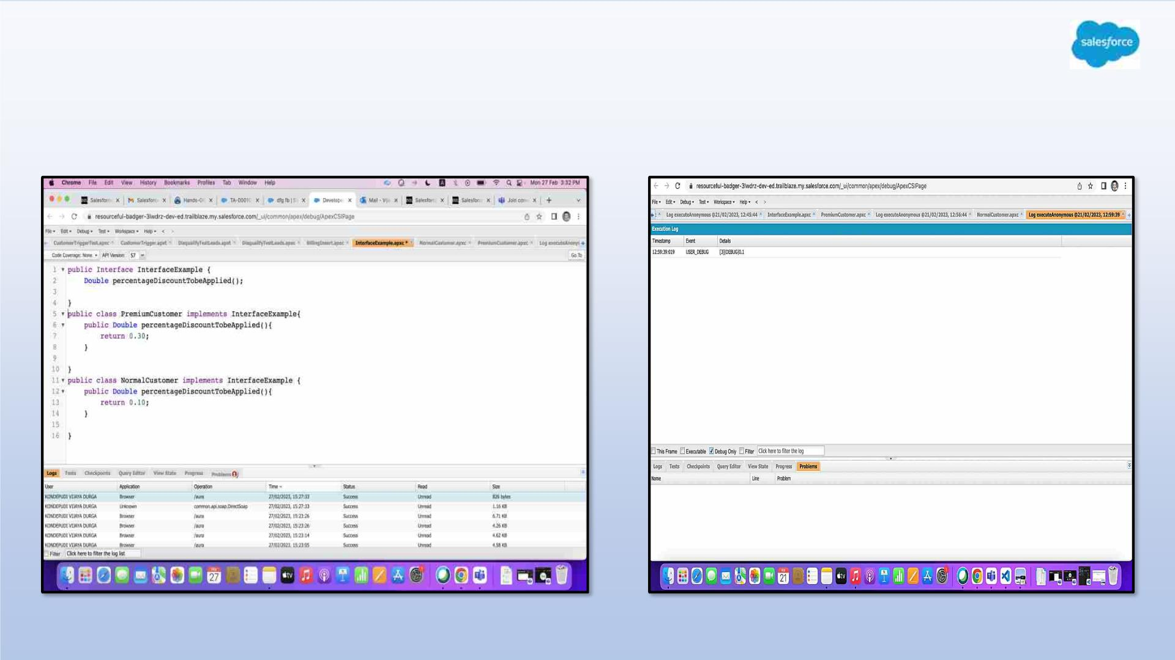
Exercise 9
Write a Class to demo the use of Interface in Apex

Slide 39
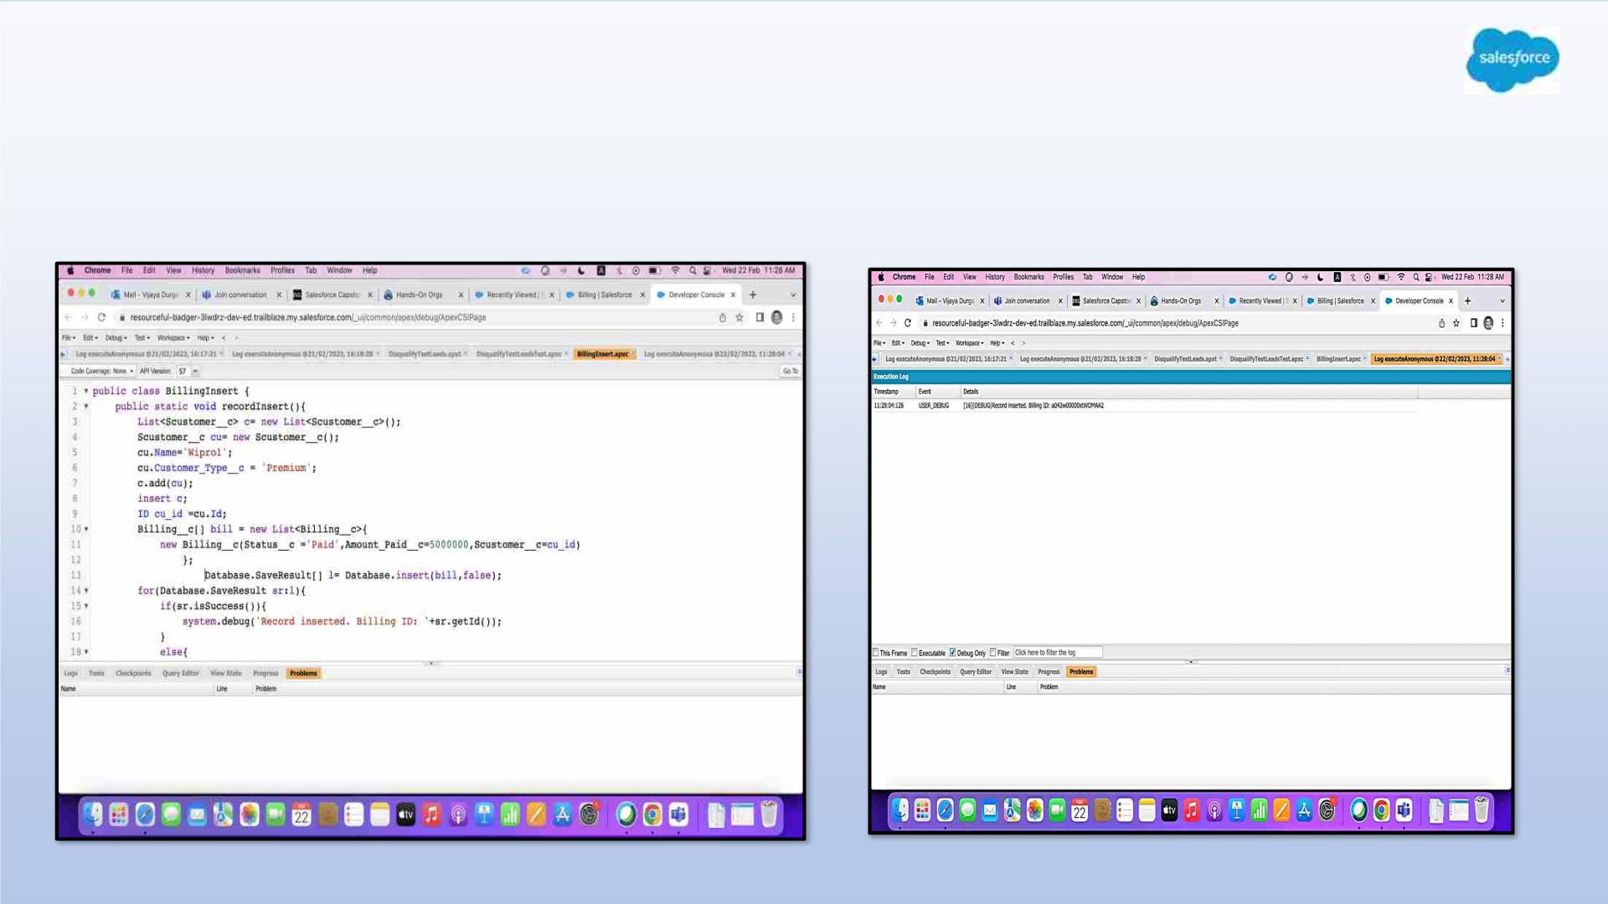
Exercise 10
Demo on DML Insert Operation Using Database methods
1.Insert a Customer Record First using simple DML Statement

Slide 40
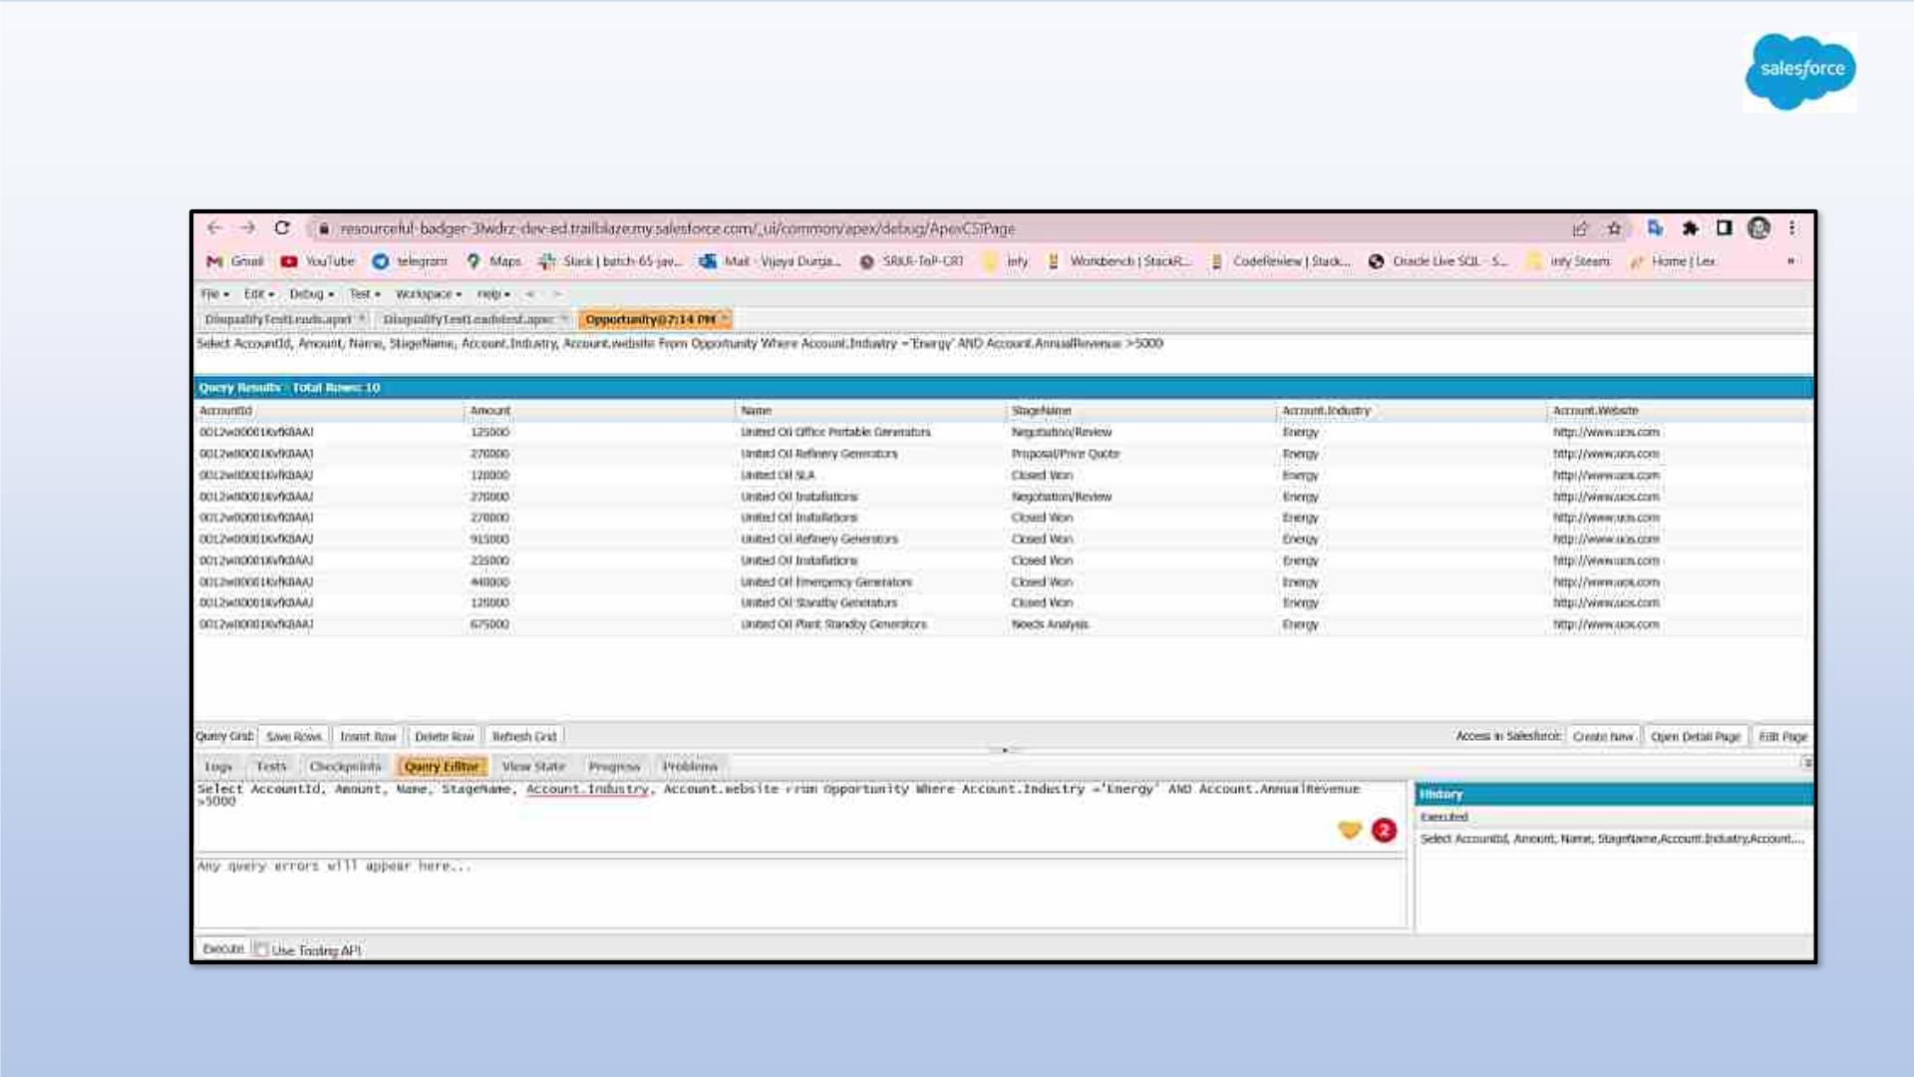
Exercise 11
Write and execute SOQL queries from Developer Console

Slide 41
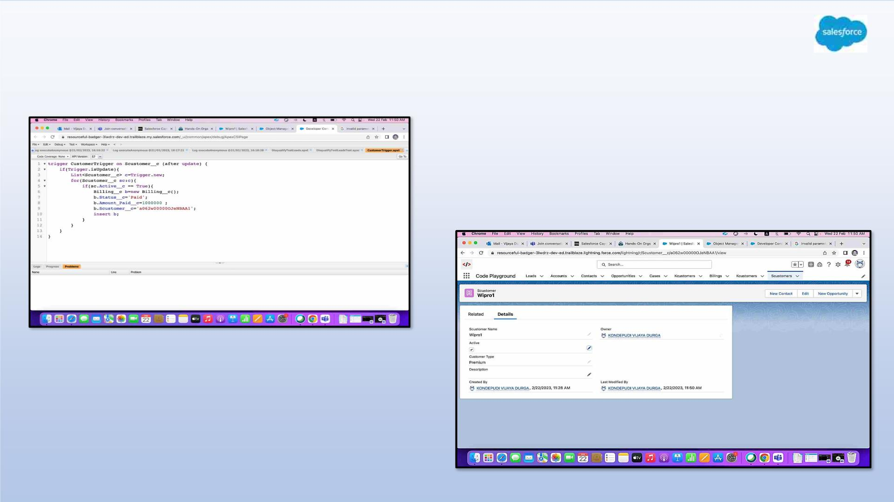
Exercise 12
Write an Apex Trigger, Name = CustomerTrigger.

Slide 42
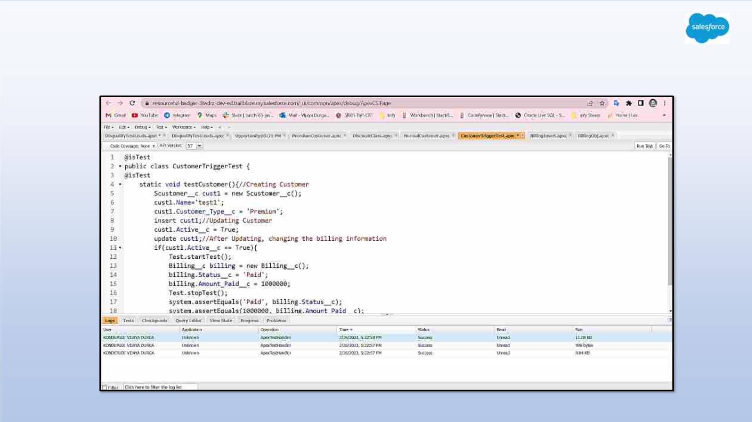
Exercise 13
Write a Test Class for CustomerTrigger.

Slide 43
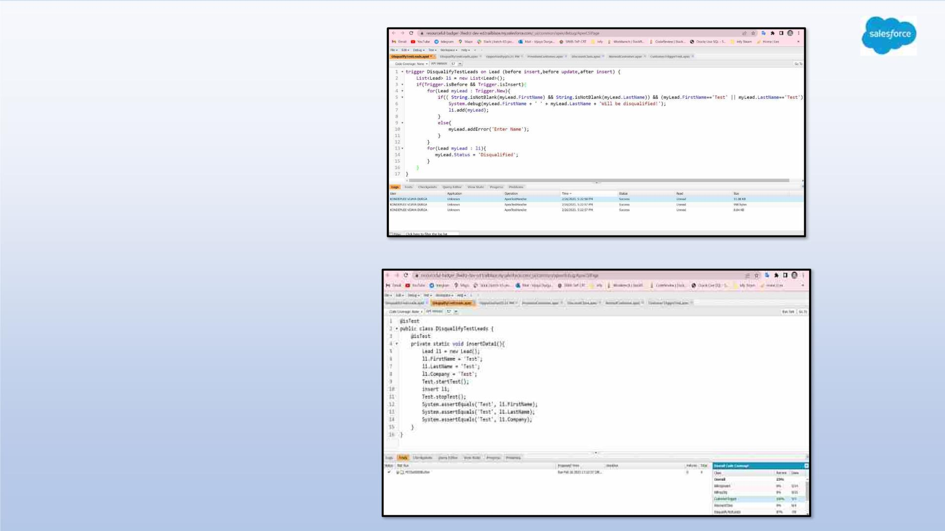
Exercise 14
ApexTrigger ,Name =
DisqualifytestLeads
Exercise 15
Write a test class for
Disqualifytestleads

Slide 44
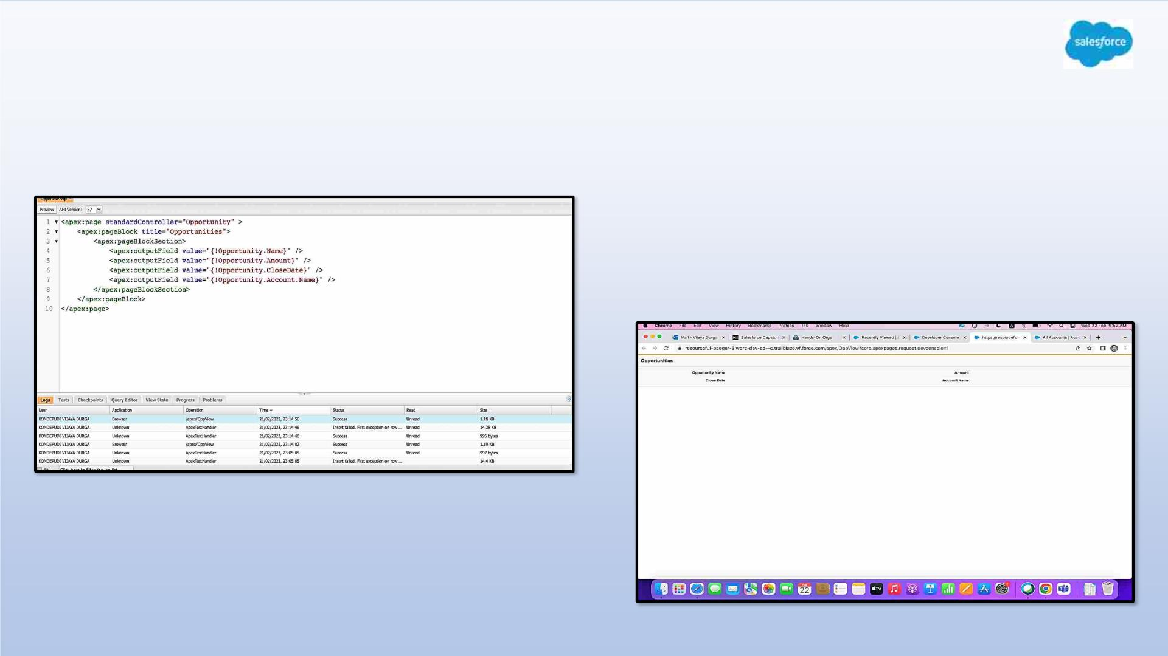
Exercise 16
Create a Visualforce page which displays Opportunity fields as output fields.

Slide 45
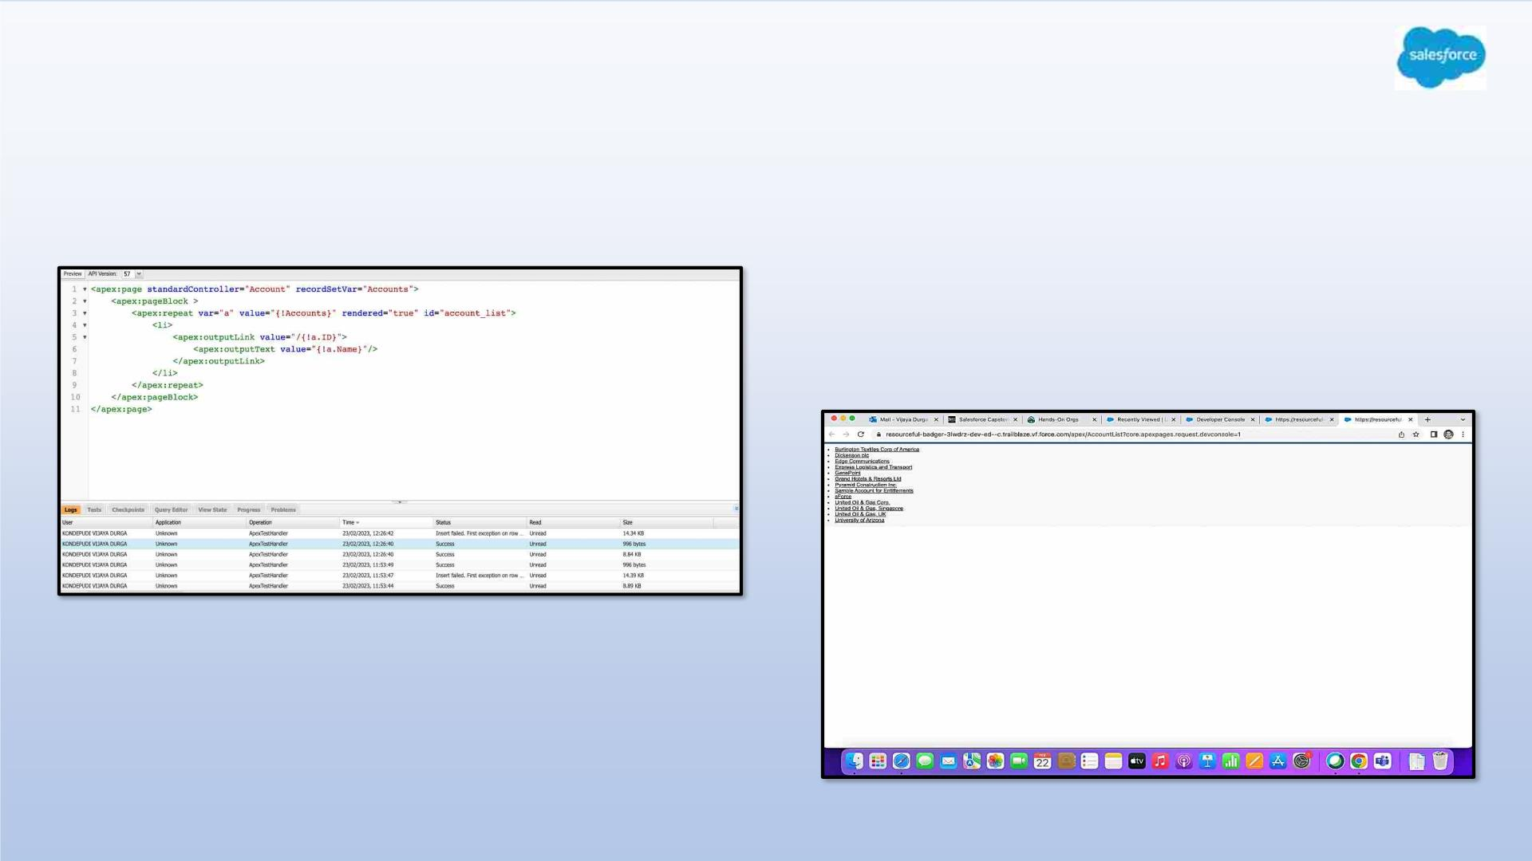
Exercise 17
Create a Visualforce page which shows a list of Accounts linked to their record
pages

Slide 46
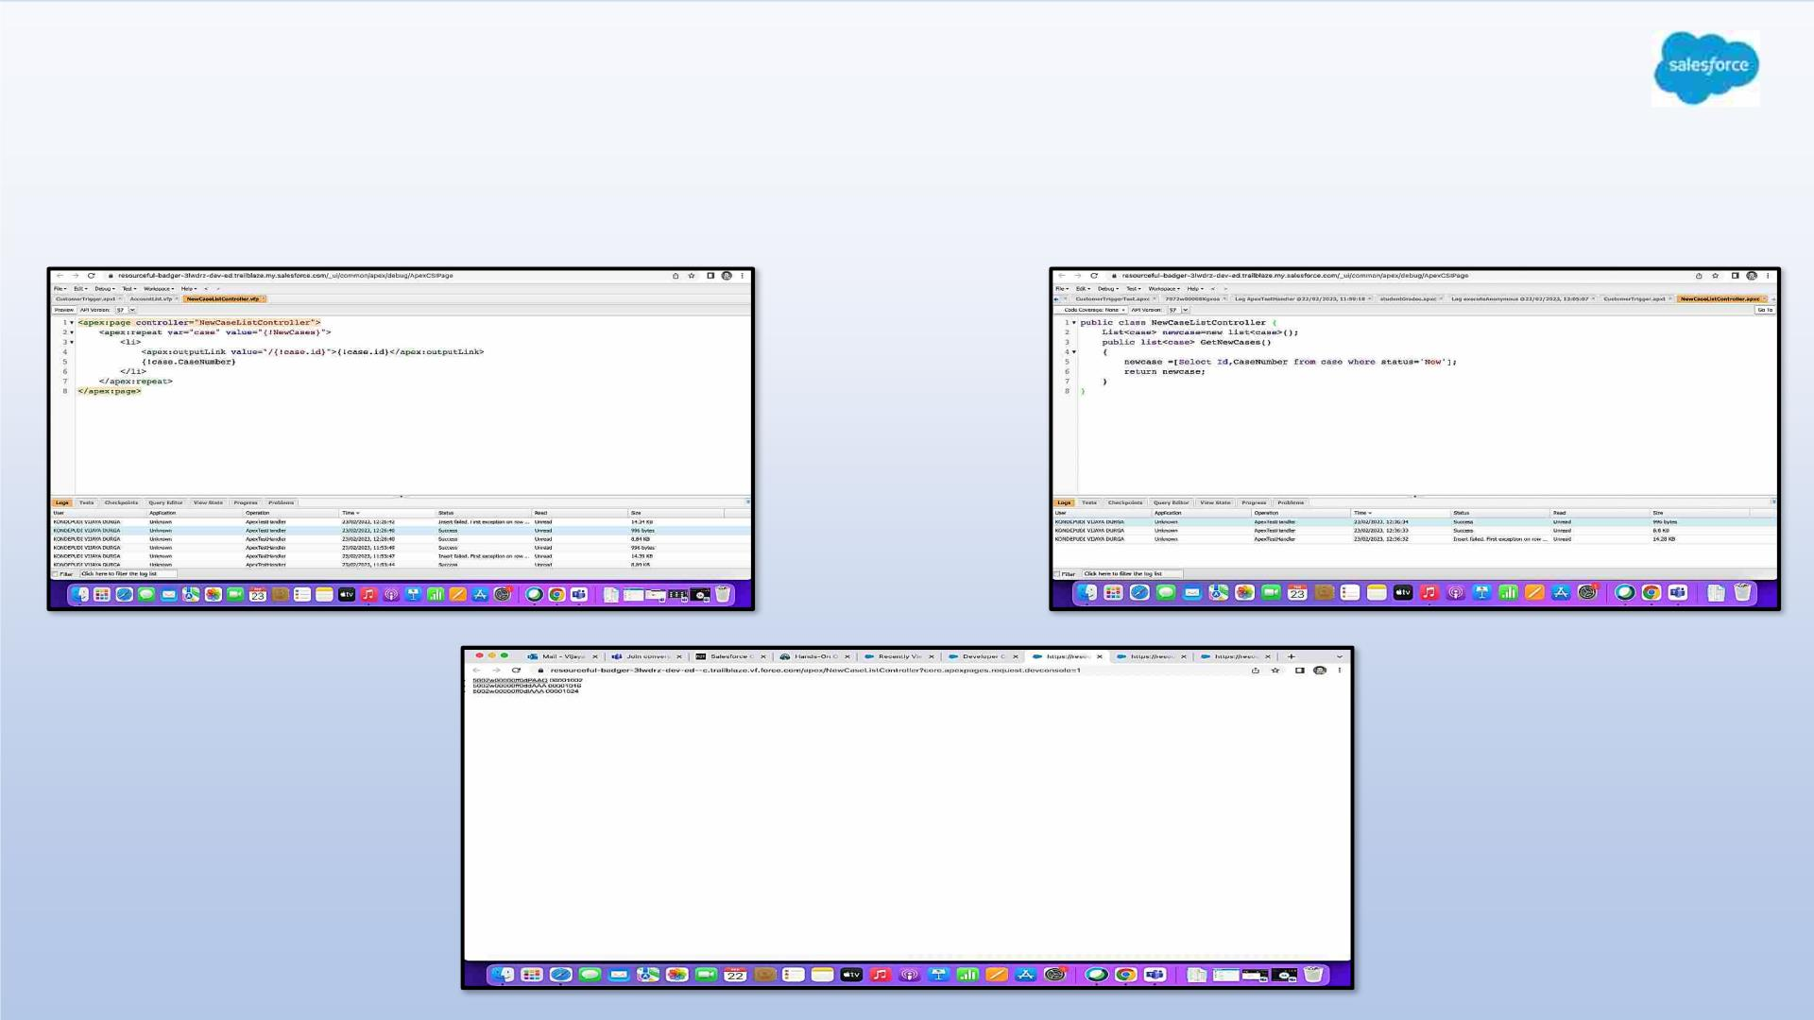
Exercise 18
Create a Visualforce page that uses a custom controller to display a list of cases
with the status of 'New'. The page must be named NewCaseList.

Slide 47

Thank
Yo

